Slide 1
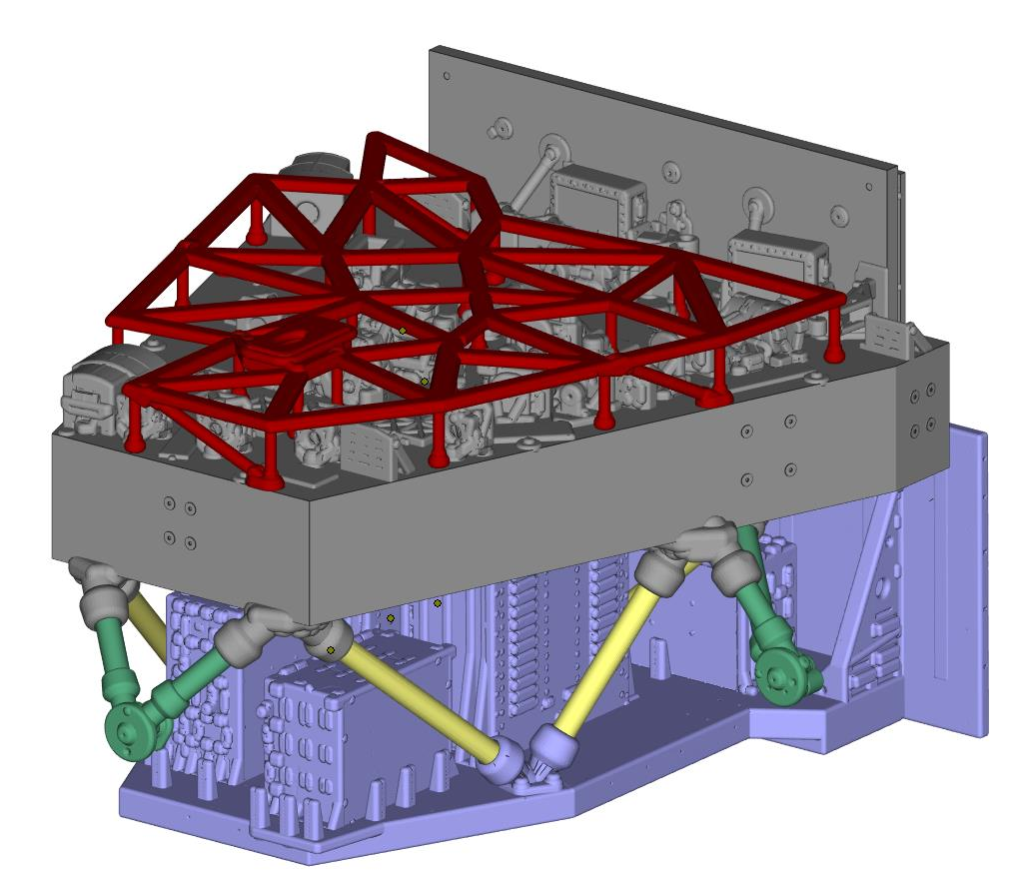
Roman-CGI
1:11 Scale Assembly

Slide 2
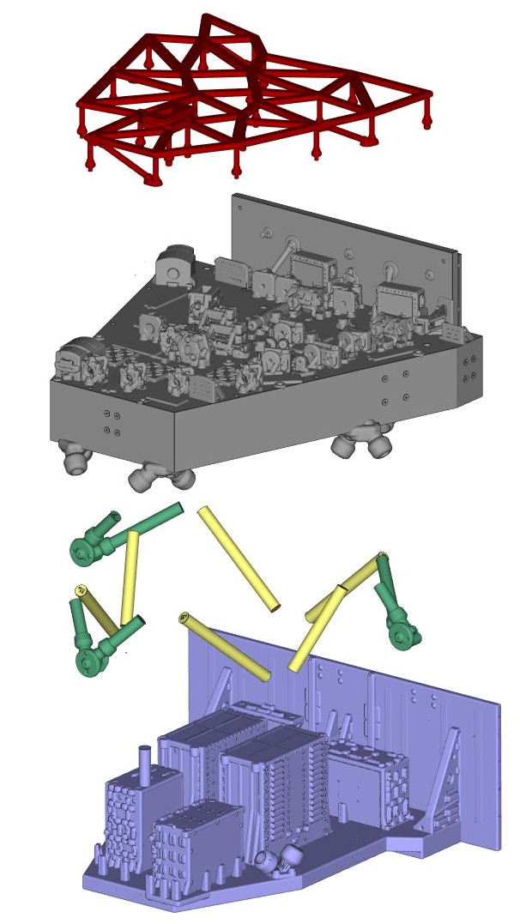
10492001-1_D-Rescaled(1in11)_C5
10492001-1_D-Rescaled(1in11)_C4
10492001-1_D-Rescaled(1in11)_C3
10492001-1_D-Rescaled(1in11)_C2
10492001-1_D-Rescaled(1in11)_C1

Slide 3
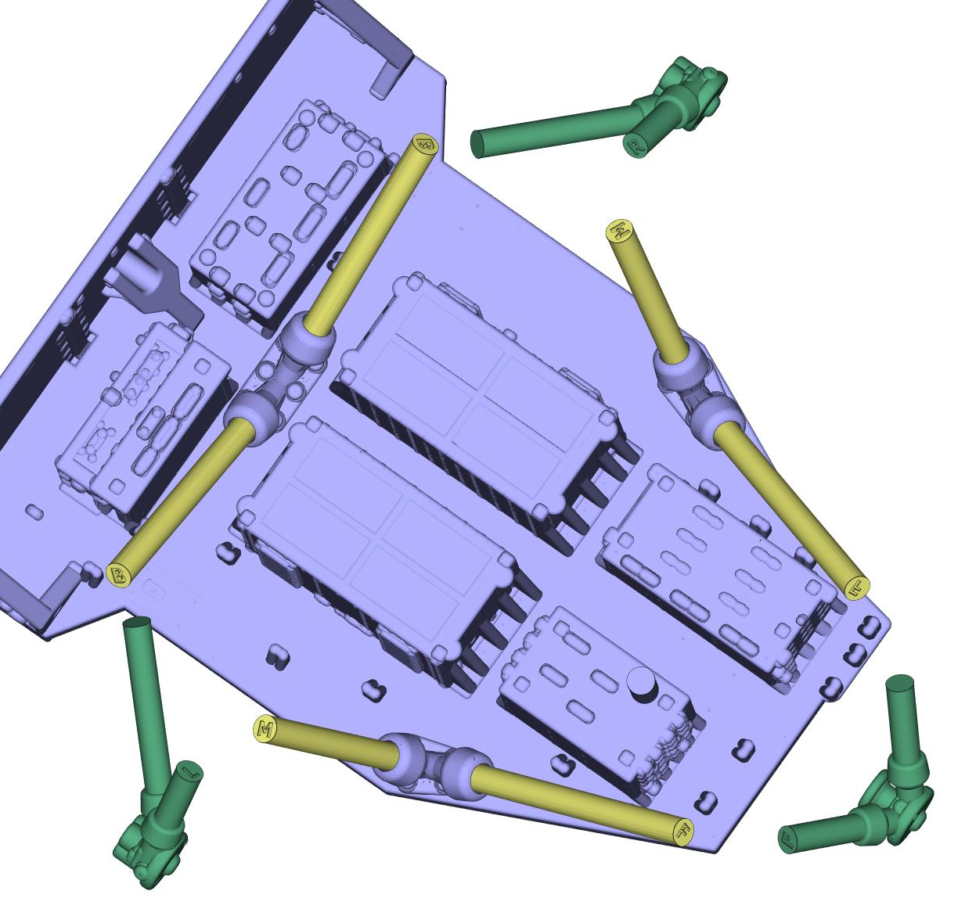
Strut Location:
B-Back Yellow
M-Middle Yellow
F-Front Yellow
R-Right Green
L-Left Green
F-Front Green

Slide 4
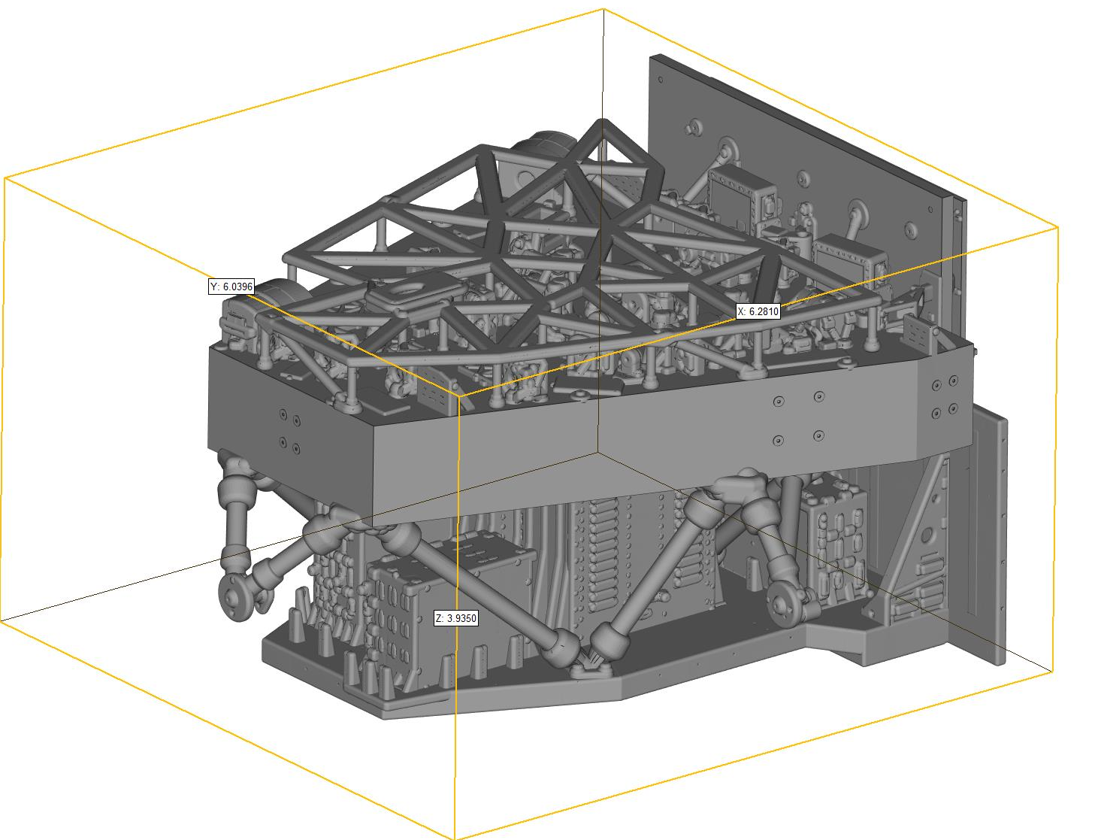
Overall Dimensions:
6.28” x 6.04” x 3.94”

