Slide 1

Roman CGI
Observing Scenario 11
Time Series Simulations
(Hybrid Lyot Coronagraph, Band 1)
John Krist
(Jet Propulsion Laboratory, California Inst. of Technology)
Version 2
Revised 10 July 2023 (flight DM characteristics)
Revised 3 March 2024 (fixed XCENTER,YCENTER header keyword values)
© 2023, California Institute of Technology. All rights reserved. Government sponsorship acknowledged.

Slide 2
Acknowledgements
CGI thermal & structural finite element models (FEMs): Josh Kempenaar, Will Krieger
Roman & CGI FEM integration, OS11 reaction wheel speeds, spacecraft FEM: NASA
Goddard Integrated Modeling Team
CGI pointing jitter model: David Arndt, Nanaz Fathpour, Milan Mandic
OS11 definition: Brian Kern
CGI STOP model execution & analysis: John Steeves, Navtej Saini, Charley Noecker
CGI Code V model: Mike Rogers
CGI LOWFS model: Brandon Dube
CGI mask designs: A.J. Riggs, Dwight Moody
CGI diffraction model & time series generation: John Krist
CGI EMCCD model: Bijan Nemati, Sam Miller, Kevin Ludwick (all U. Alabamba, Huntsville)

Slide 3
Preface
These HLC simulations are intended for evaluating post-processing algorithms
Observing Scenario 11 (OS11) is representative of a realistic observing sequence, but does not reflect any particular requirements for total observation time, number of rolls, etc. (there is a limit of about ±13° on maximum roll relative to the nominal solar normal orientation)
OS11 is expected to be the last end-to-end time series
The thermal+structural modeling results are significantly better than requirements
The diffraction models intentionally include misalignments, fabrication errors, and uncertainties and do not produce the best possible dark holes, but also may be better than what we really get (they are better than requirements).

Slide 4
Some definitions
primary-normalized flux: image is normalized to the flux incident on the illuminated area of the primary mirror. There are no losses from reflections, filters, QE, etc, but there are losses from masks. In the absence of masks, the total image intensity would be 1.0 over an unlimited extent.
normalized intensity: the per-pixel brightness of the dark hole divided by the peak pixel of the unocculted star. This is sort of a poor man’s contrast (because it does not account for field variations in the PSF, especially near the IWA).
detector sampling: the detector pixel size is 0.5 λ/D @ λ = 500 nm (0.435 λ/D @ 575 nm), which is 21.8 mas.
Array dimensions are specified here in IDL ordering (fastest-varying index 1st, slowest last).

Slide 5
CGI HLC Band 1
Hybrid Lyot Coronagraph (HLC)
  DMs tailor wavefront to compensate for telescope obscurations
  amplitude-and-phase modulating focal plane mask (FPM); FPM radius = 2.8 λ_{c}/D (λ_{c} = 575 nm)
  Lyot stop
Field stop sets outer radius = 9.7 λ_{c}/D
Science region is r = 3 – 9 λ_{c}/D over 360°
Band 1 is 10% width centered at 575 nm
λ_{c}/D = 50.2 mas for λ_{c} = 575 nm

Slide 6
OS 11
  Begin with slew from a WFI High Latitude Survey target to the bright reference star (ζ Pup, V=2.25, O4I, D_{star}=0.4 mas), then spend days to settle and restore the dark hole
    Assume dark hole was previously dug at some earlier time and just needs some tweaking
    Reference star chosen to keep solar pitch change to ~3.5° to avoid large thermal changes
  Observation cycle:
    ~¾ hour of imaging on ζ Pup (1st observation begins at hour 170 in the timeline)
    slew to the target star (47 UMa, V=5.04, G1V, D_{star}=0.9 mas)
    100 minutes of imaging 47 UMa at each of 4 rolls, alternating between -13° and +13° for a total of 400 min per cycle
    slew to ζ Pup
    ~¾ hour of imaging on ζ Pup
  There are 4 cycles, with time between the 2nd and 3rd for one iteration of dark hole maintenance (not reproduced in these simulations)
    4.1 hours of total integration on ζ Pup
    26.4 hours of total integration on 47 UMa (both roll angles)

Slide 7
OS11 Nomenclature
Reference star images have batch ID’s starting with 0 and incrementing by 1 with each visit
Target star images have batch ID’s starting with 100 and incrementing by 1 every roll;
each cycle of target imaging starts at the next increment of 100
Cycle 1
Cycle 2
Cycle 3
Cycle 4
Batch ID=
0
100
101
102
103
1
200
201
202
203
2
3
300
301
302
303
4
400
401
402
403
5
Reference
Reference
Reference
Reference
Reference
Reference
Target (Cycle 4, Roll 2 = -13°)
Target (Cycle 1, Roll 1 = -13°)
Target (Cycle 4, Roll 4 = -13°)
Target (Cycle 1, Roll 3 = -13°)
Target (Cycle 2, Roll 2 = -13°)
Target (Cycle 2, Roll 4 = -13°)
Target (Cycle 3, Roll 1 = -13°)
Target (Cycle 3, Roll 3 = -13°)
Target (Cycle 4, Roll 1 = +13°)
Target (Cycle 1, Roll 2 = +13°)
Target (Cycle 4, Roll 3 = +13°)
Target (Cycle 1, Roll 4 = +13°)
Target (Cycle 2, Roll 1 = +13°)
Target (Cycle 2, Roll 3 = +13°)
Target (Cycle 3, Roll 2 = +13°)
Target (Cycle 3, Roll 4 = +13°)
Hours
EFC Probes: apply pre-defined DM patterns & record resulting
image changes; no images are provided for this span
GITL: Download probe images to ground, use them to derive
wavefront error, compute new DM solutions, upload them
to CGI

Slide 8
OS11 Modeling Timesteps
The STOP (finite element & optical ray trace) model was run with 15 min timesteps to derive aberration & alignment changes
  Misalignment-induced pointing offsets were compensated by repointing the observatory during ray tracing to ensure the star is always perfectly centered on the FPM (this excludes pointing jitter, which is a separate thing)
  Results were then interpolated to 1 min timesteps
  Includes thermal effects from solar angles, heaters, CGI mechanism movements (PAMs) & electronics
The LOWFS model was run to measure aberration changes, which were used to derive DM and focus control compensations in the system model (see later page)
For each timestep, PROPER produced complex-valued speckle electric fields with 0.1 λ_{c}/D sampling for 7 wavelengths at each of 4 polarization states (combinations of ±45° in, 0° & 90° out)
The pointing jitter model, using reaction wheel speeds tailored for OS11, produced RMS X,Y pointing error jitters at 0.25 sec timesteps, interpolated to 1 min timesteps
At 1st timestep, ΔE-field changes were recorded for a variety of source offsets to create a linear optical model (LOM); At each subsequent timestep, each LOM ΔE-field was added to that timestep’s E-field and converted to intensity, creating an ensemble of offset-source images; a weighting function based on the Gaussian jitter & stellar size was applied to these and the resulting images summed to create that timestep’s final image (all this was done separately for each wavelength and polarization component)
The images from the four polarizations were combined
Appropriate stellar spectra were multiplied by the system throughput curve to weight the monochromatic images, which were then summed to produce broadband images with appropriate flux rates (e-/sec at the detector)
The images were upsampled via interpolation to 5x-finer-than-CCD pixel sampling, then binned to CCD pixels; these detector-noise-free images are provided as *_noiseless.fits

Slide 9
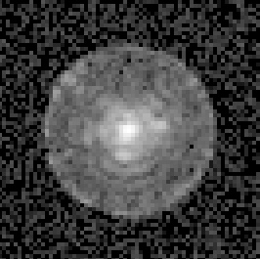
Simulation Flow (OS 11)
Reaction
wheel speeds
Dynamics
model
Pointing
errors
quasi-LOWFS
model
Pointing
jitter
Observing scenario
times & orientations
LOWFS model
(LOWFSSim)
CGI power profile
(mechanisms &
heaters)
Finite Element Model
STOP model
(Thermal Desktop,
NASTRAN,
Sigfit + Code V)
Wavefront &
alignment changes
DM & focus
corrections
>3M nodes,
includes heater
control loops
Diffraction
model
(PROPER)
PROPER: John Krist (JPL)
LOWFSSim: Brandon Dube (JPL)
emccd_detect & photon_count:
Bijan Nemati, Sam Miller,
Kevin Ludwick (UAH)
Photon
counting
(photon_count)
Detector
model
(emccd_detect)
CGI speckle
images

Slide 10
Errors included in OS11 HLC time series optical model
Static optical errors
  Measured OTA & TCA (unmounted) optical errors, synthetic CGI optical errors matching measured (but not usable due to artifacts) error maps
  Stand-in for phase-retrieval-derived optical error map (used for initial phase flattening and in control model); uses computed phase errors at FPM entrance pupil, multiplied by 1.1x to represent phase retrieval errors
  Polarization aberrations (4 components: orthogonal input terms, orthogonal output terms & cross-terms)
  Bulk shear of CGI relative to instrument carrier (@ FSM) of 0.14% of pupil diameter
Z4-Z37 aberrations vs time due to surface deformations & misalignments
OTA & TCA optics shifts vs time (implemented via shifts of optical error maps)
Bulk X,Y CGI shear vs time at IC-CGI interface (in addition to initial shear)
“Known” DM misalignments (included in system & control model)
  0.14 mm, -0.14 mm offsets (DM1,2)
  0.11°, -0.11° rotations (DM1, 2)
“Unknown” DM misalignments (addition to known, included in system model but not control)
  0.11 mm, -0.11 mm (DM1, 2)
  0.1°, -0.1° rotations (DM1, 2)
  0.3% mm/actuator spatial scale change
  DM shifts vs time due to bench deformation, IC-CGI interface tilts
Measured flight DM characteristics, including dead actuators and actuator gain variations
DM bias = 40 V, neighbor rule enforced
15-bit DAC DM stroke quantization
CGI DM & Lyot stop offsets vs time from bench deformations & tilts at IC-CGI interface
DM surface change due to thermal variations
Imperfect FPM (known errors included in system & control models, unknown included only in system model)
  Known error: 1° clocking error
  Unknown errors: -10 nm PMGI bias error, 5% PMGI height error, 0.5 μm PMGI misalignment, 5% Ni bias error, 0.14° unknown clocking error, 0.82 μm FPM offset, 0.4% scale; 70 μm offset along optical axis
Note: 1-iteration “refresh” EFC wavefront control in middle of OS11 not included here

Slide 11
Current Modeling Uncertainty Factors (MUFs)
STOP MUF
  2x structural deformation MUF
    increases beam shear, wavefront error drift by 2x
Dynamics MUFs
  Frequency-dependent jitter MUFs
    3x (<20 Hz), 4.27x (40-100 Hz), 8x (>100 Hz)
Diffraction MUFs
  2x contrast sensitivity to low-order errors (jitter, polarization)
  1.5x polarization aberrations
Always
included
Included
only when
specified

Slide 12
LOWFS Model
LOWFS model developed & executed by Brandon Dube (JPL)
  Diffraction model with STOP-computed Zernikes as input
  Uses same algorithms as flight for sensing and deriving corrections
  Includes stellar fluxes & spectral types, detector effects
LOWFS-measured Zernikes reported every 10 s with 100 s sensing bandwidth
LOWFS is currently tuned for requirements-level aberration changes, which are much larger than those seen in OS11, so there is significant high-temporal-frequency noise that averages down over the full imaging timescales
Defocus (Z4) controlled with Focus Correction Mechanism, Z5-Z11 with DM1
Real LOWFS will be used to measure & control source offsets, but in these simulations those are handled separately when computing jitter

Slide 13
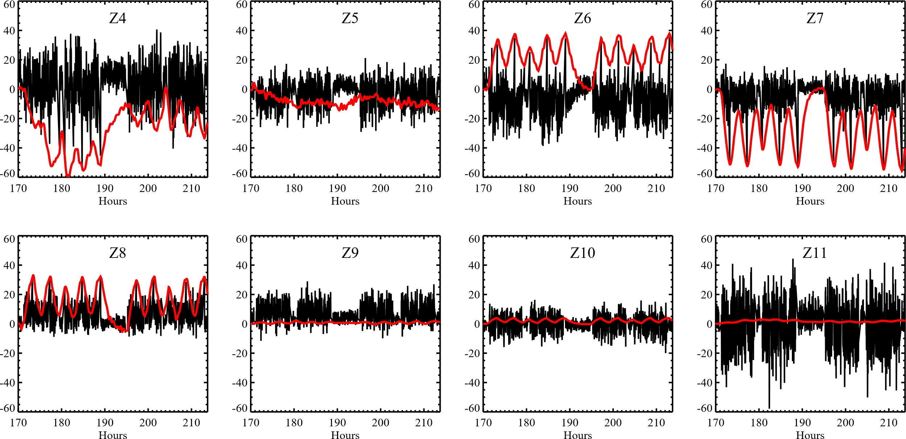
OS11 Zernike Aberrations
Noll ordering
WFE pm RMS
WFE pm RMS
red = STOP-computed zernikes, black = LOWFS-corrected zernikes (1 m timesteps)

Slide 14
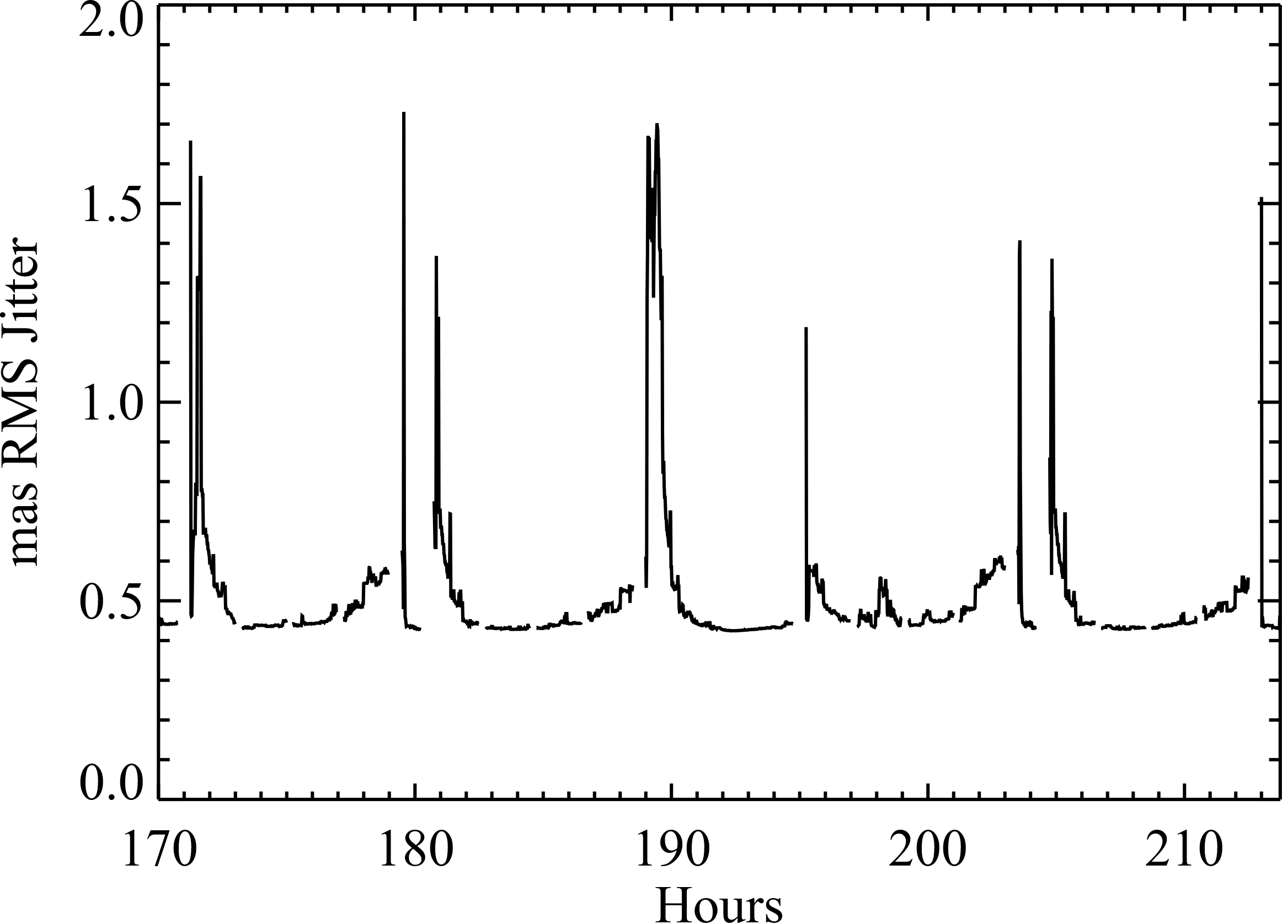
OS11 Post-correction Jitter
(RSS of X & Y RMS jitters)
The jitter floor here is set by a 0.3 mas RMS (per axis) system noise that is RSSed with
the predicted post-steering-mirror jitter.

Slide 15
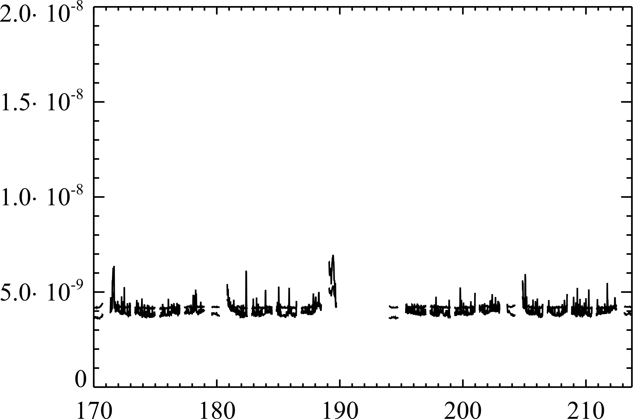
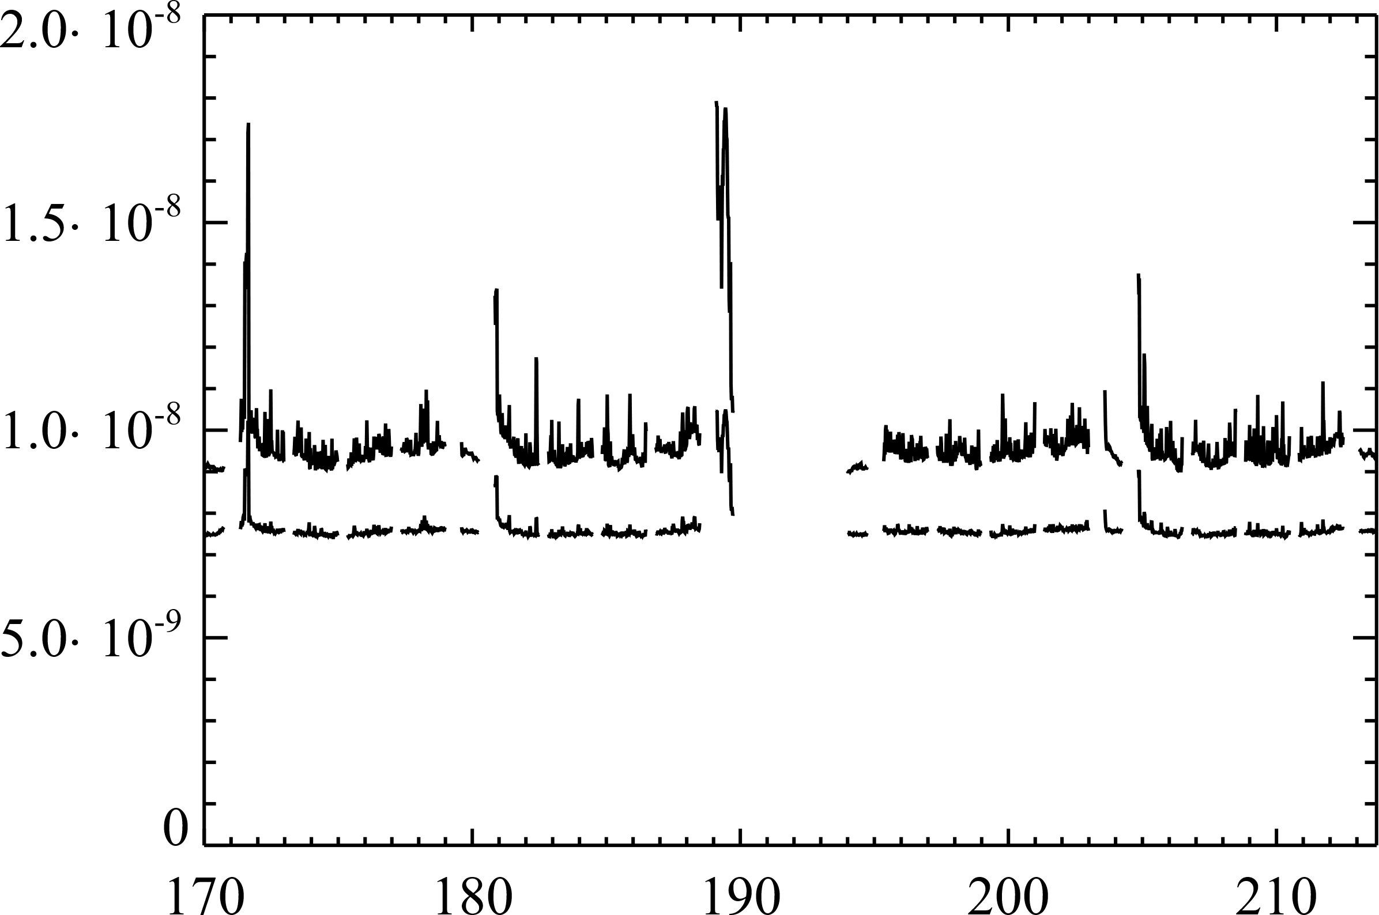
HLC OS11 Dark Hole Mean NI
Without Optical MUFs
With Optical MUFs
Mean NI
3 – 4 λ/D
3 – 9 λ/D
3 – 9 λ/D
3 – 4 λ/D
Hours
Hours
Mean NI over time:
4.0 x 10⁻⁹ (3 – 4 λ/D)
4.2 x 10⁻⁹ (3 – 9 λ/D)
Mean NI over time:
9.7 x 10⁻⁹ (3 – 4 λ/D)
7.9 x 10⁻⁹ (3 – 9 λ/D)

Slide 16
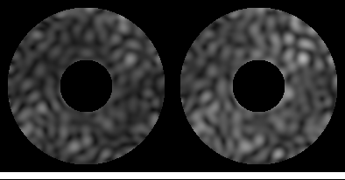
HLC OS11 Movie
3 min intervals
(play in presentation mode)
No optical MUFs
With optical MUFs
High spatial frequency fluttering caused by correction of low-order aberration
changes by the high-order DM, plus LOWFS measurement errors; without LOWFS,
changes at the IWA would be greater. Flashes are caused by high jitter spikes.

Slide 17
HLC OS11 Time Series Files
hlc_os11_planet_r3.5_t-13_oversampled.fits, hlc_os11_planet_r3.5_t13_oversampled.fits, hlc_os11_planet_4.5_t117_oversampled.fits, hlc_os11 planet_r4.5_t143_oversampled.fits:
Simulations of point sources offset from the star by 3.5 & 4.5 λ_{c}/D (176 & 226 mas) at angles of -13°, +13°, 117°, & 143° (representing the two rolls). These images oversample the detector pixels by 5x and should be 5x5 binned down to match. Small (<2°) adjustments to the roll angle can be implemented by shifting the images via interpolation (don’t rotate them). The images are primary-normalized flux. Each image is [nx=275,ny=275] pixels.
hlc_os11_psfs_oversampled.fits:
Simulations of point sources offset from the star by a variety of irregularly-spaced radial and azimuthal values. These images oversample the detector pixels by 5x and should be 5x5 binned down to match. Small (<2°) adjustments to the roll angle can be implemented by shifting the images via interpolation prior to binning (don’t rotate them). The images are primary-normalized flux. The file dimensions are [nx=275,ny=275,num_radial_offsets=21,num_azimuthal_offsets=36].
hlc_os11_psfs_radial_offsets.fits [n=21], hlc_os11_psfs_azimuth_offsets.fits [n=36]:
The radial and azimuthal offsets are provided in the 1-D FITS files.
hlc_os11_darkhole_noiseless.fits, hlc_os11_darkhole_muf_noiseless.fits:
OS11 time series speckle field images (no planets) without and with optical MUFs at CCD pixel sampling at 1 minute timesteps. The file dimensions are [nx=55,ny=55,ntimesteps=1830]. This contains all reference and target star images as generated by the models (1 minute cadence). The image values are in electrons/sec (pre-gain) for the given star as detected (includes stellar spectrum & flux and system losses, including QE); these are prior to electron multiplication. The input parameters, batch IDs, and other information for each timestep are in the file hlc_os11_inputs.fits (described on the next page). This file is to be interpolated over time to match chosen camera framerates.
hlc_os11_no_fpm.fits:
Unocculted PSF (star image with no FPM) at CCD sampling; primary-normalized flux units; use to convert dark hole image values to normalized intensity (NI) by (1) multiply PSF by the target or reference star flux, as appropriate, (2) divide the dark hole image by the maximum PSF value.

Slide 18
hlc_os11_inputs.fits
This file is a FITS 2D array, [nterms=81,ntimesteps=1830] providing info for the
corresponding image provided in hlc_os11_darkhole_*.fits.
nterm (starting at 0) =
0: Time of observation (hours, starting at 170)
1: Star ID (1 = target, 2 = reference)
2: Batch ID (see OS11 Nomenclature slide)
3: Roll; degrees
4-45: Input low order aberrations; Noll-ordered Zernikes, Z4-Z45; meters RMS
46-53: LOWFS-derived low order corrections (Z4-Z11); meters RMS
54-59: Optical surface X shift; [secondary, POMA fold, M3, M4, M5, TT fold]; meters
60-65: Optical surface Y shift; meters
66-67: CGI X & Y shear at instrument carrier interface (FSM); meters
68-69: DM1 X & Y shear; meters
70-71: DM2 X & Y shear; meters
72-73: DM1 & DM2 temperature; Kelvins
74-75: SPAM (SPC pupil mask) X & Y shear; meters (not used for HLC)
76-77: LSAM (Lyot stop) X & Y shear; meters
78-79: X & Y post-FSM pointing jitter; mas RMS per axis
80: Focus correction mechanism offset to compensate Z4; meters

Slide 19
Fluxes
Flux rates for each star are provided in the header of hlc_os11_darkhole*.fits as the keywords TARGFLUX and REFFLUX
  rates are appropriate for stellar type and brightness
  units are total electrons/sec from source prior to electron multiplication (no gain applied)
  includes losses from reflections, filters, QE, but not CGI masks
  mask losses are included in the image fluxes
Provided PSF (*_psfs_*.fits) & planet (*_planet__*.fits) images are in primary-normalized flux units; to convert to planet e⁻/sec, multiply by planet contrast (e.g., 5e-9) and TARGFLUX

Slide 20
Creating Field Point Sources with CGISim
CGISim is a Python program that generates CGI dark hole and field point source
images using the PROPER propagation library and the CGI diffraction model. You
can use it to produce field point source images with any offset from the star. It can
be downloaded from https://sourceforge.net/projects/cgisim. Be sure to read the
manual to understand how the images are normalized. For the “spec” mode, CGISim
will generate images for 30 wavelengths.
Example code is shown below to generate an off-axis source at (x,y)=(+300,-50) mas.
import cgisim_jpl as cgisim
import proper
import roman_phasec_proper_jpl
cgi_mode = 'excam'
cor_type = 'hlc'
bandpass = '1'
polaxis = -10 # compute images for mean X+Y polarization (don't compute at each polarization)
# read in DM pattern provided with Phase C CGI model
file_dir = roman_phasec_proper_jpl.lib_dir + '/examples/'
dm1 = proper.prop_fits_read( file_dir+'hlc_best_contrast_dm1.fits' )
dm2 = proper.prop_fits_read( file_dir+'hlc_best_contrast_dm2.fits' )
params = {'source_x_offset_mas':300.0, 'source_y_offset_mas':-50.0,
'use_dm1':1, 'dm1_m':dm2, 'use_dm2':1, 'dm2_m':dm2}
psf = cgisim.rcgisim( cgi_mode, cor_type, bandpass, polaxis, params, output_file= 'psf.fits' )

Slide 21
Creating Planet Images
The hlc_os11_planet_*.fits images are oversampled by 5x relative to the detector pixels, so you must first do 5x5 binning (be sure to conserve total intensity)
Multiply the binned image by planet/star contrast ratio and stellar flux, as described in the previous slide, to convert to e⁻/sec flux units (pre-electron-amplification)
Add the planet images to the target images from hlc_os11_darkhole_*.fits, matching appropriate orientations
Interpolate the images over time to match the exposure frame time you have selected (do this with images having the same batch ID)
Pass these images through the emccd_detect routine with the appropriate gains and frame times (described later)
Convert from raw CCD images to photon-counted images using the PhotonCount routine (described later)
You can create your own planet PSFs for specific locations using the cgisim Python
package (https://sourceforge.net/projects/cgisim). Pay careful attention to how the
images are normalized.

Slide 22
Creating Disk Images
Resample your disk model to match the 5x oversampled PSF images (4.36 mas/pix)
  The disk model should be normalized relative to a total stellar flux of 1.0
  Create two model images, matching the two roll angles
Convolve sub-regions of the models with the closest-offset PSF from hlc_os11_psfs_oversampled.fits (this will both blur the disk and apply the mask throughput losses)
5x5 bin the convolved models to detector sampling, conserving total flux
Multiply the binned images by the stellar flux, as described in a previous slide, to convert to e⁻/sec flux units (pre-electron-amplification)
Add the disk image to the target images from hlc_os11_darkhole_*.fits, matching appropriate orientations
Interpolate the images over time to match the exposure frame time (do this with images having the same batch ID)
Pass these images through the emccd_detect routine with the appropriate gains and frame times to create raw CCD images (described later)
Convert from raw CCD images to photon-counted images using the PhotonCount routine (described later)
For a quick-and-dirty simulation, convolve the disk model with a single PSF and then multiply by hlc_sky_transmission_oversampled.fits

Slide 23
emccd_detect
emccd_detect is a Python package for EMCCD modeling provided by Bijan Nemati, Sam Miller, & Kevin Ludwick from UAH
  https://github.com/wfirst-cgi/emccd_detect
The user must specify at least the frame time and EM gain (other parameter have defaults)
  max gain is 5000
    Images with gains of <1000 are processed as conventional CCD images (no photon counting), but with high (100 e⁻/frame) read noise
  shoot for per-pixel flux rates of ~0.1 e⁻/frame (post-amplification) to avoid coincidence losses during photon-counting post-processing
Output is a “raw” CCD image that must be photon-counted by PhotonCount
CTE not currently included

Slide 24
PhotonCount
PhotonCount is a Python package for EMCCD photon-counting post-processing provided by Bijan Nemati, Sam Miller, & Kevin Ludwick from UAH
  https://github.com/wfirst-cgi/PhotonCount
The inputs are
  data cube of raw EMCCD images
  EM gain
  photon counting threshold (4x-5x the read noise; I use 500)
Output image is the mean expected pre-amplified e⁻/frame, corrected for coincidence and threshold losses
Do not use PhotonCount to process frames taken in analog mode (gain < 1000) – process those like a conventional CCD image (one with high read noise, ~100 e⁻/frame)
See B. Nemati, “Photon counting and precision photometry for the Roman Space Telescope Coronagraph”, Proc. SPIE, 11443, 114435F (2020)

Slide 25
Example Files & Routine
hlc_os11_frames_with_planets.fits, hlc_os11_frames_with_planets_muf.fits: Temporal resampling of hlc_os11_darkhole*.fits for 3.4 sec reference star images and 39.0 sec target star images (no optical MUFs) and 2.2 and 27.0 sec for reference & target (with MUFs); flux units remain e⁻/sec (no gain). 0.3 sec separation between frames allocated for readout time; The two planets provided in hlc_os11_planet_*.fits were added at the appropriate target rolls with contrasts of 2e-9 @ 4.5 λ/D and 5e-9 @ 3.5 λ/D.
hlc_os11_batch_info.txt, hlc_os11_batch_muf_info.txt: Text files listing parameters corresponding to entries, in sequence, in the file hlc_os11_frames_with_planets*.fits for each batch: batch ID, batch start time, star ID, roll, seconds per frame, gain, and number of frames.
hlc_os11_example.py: Python script illustrating how to process images through emccd_detect and PhotonCount. Takes as inputs the files listed above, adds EMCCD noise, converts to flux maps, and then does simple RDI to create post-processed planet images. It is assumed that users will use this as a guide and will generate their own image stacks with different gain and exposure times, scenes, etc. Note that cosmic rays are NOT added. Outputs of this script are:
  hlc_os11_flux_maps*.fits: mean expected flux per batch (photon counting) or mean computed flux per batch (conventional) in e⁻/sec (no gain), one map per batch
  hlc_os11_true_flux_maps*.fits: actual mean flux maps from averaging each batch in the noiseless input images file
  example_reference_image*.fits, example_target_roll_minus_image*.fits, example_target_roll_plus_image*.fits: mean of all reference and target (per roll) images in hlc_os11_flux_maps*.fits
  example_rdi_roll_minus_image*.fits, example_rdi_roll_plus_image*.fits: simple RDI results for each roll

Slide 26
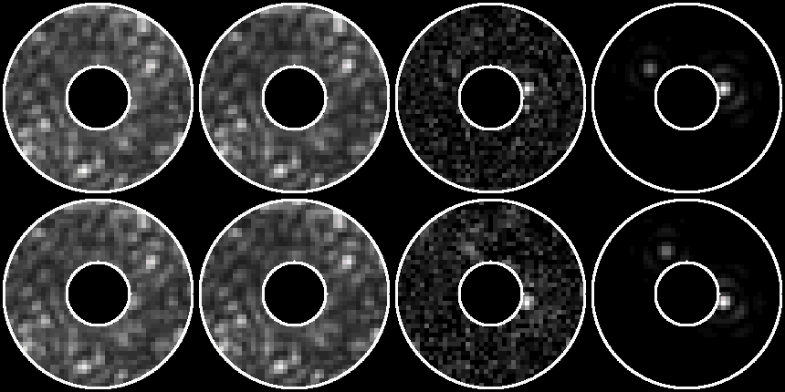
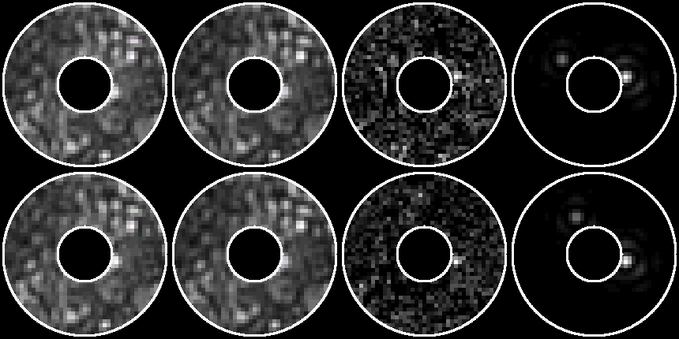
Results from hlc_os11_example.py
Target +
Planets
Actual
Planets
Reference
Difference
Shown here are
all frames for each
star/roll summed
with no rejection
+Roll
Without
Optical
MUFs
-Roll
Shown over
r = 3 – 9 λ/D
2 x 10⁻⁹ @
r = 4.5 λ/D
5 x 10⁻⁹ @
r = 3.5 λ/D
+Roll
With
Optical
MUFs
-Roll

Slide 27
Conclusions
OS11 results are much better than requirements
The speckle variations over time are due to (from most to least) pointing jitter, LOWFS measurement errors (short timescales), DM low-order correction errors, pupil misalignments.
  Without LOWFS correction of Z4-Z11, coma would be the 2nd most important.
  Integrated over all observations, the LOWFS errors largely average out and result in ~2x more stable speckles near the IWA
Detector noise is a significant limiting factor

Slide 28
Additional STOP Results

Slide 29
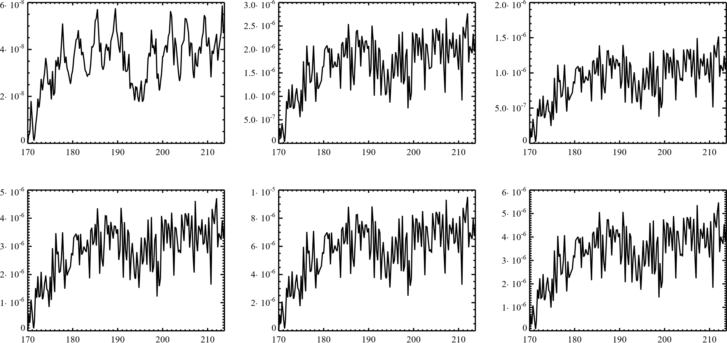
OTA & TCA beam shears
from thermally-induced displacements
(ACS corrected, no jitter)
Secondary
POMA Fold
M3
Shear / Beam Diameter
M4
M5
TT Fold
Hours

Slide 30
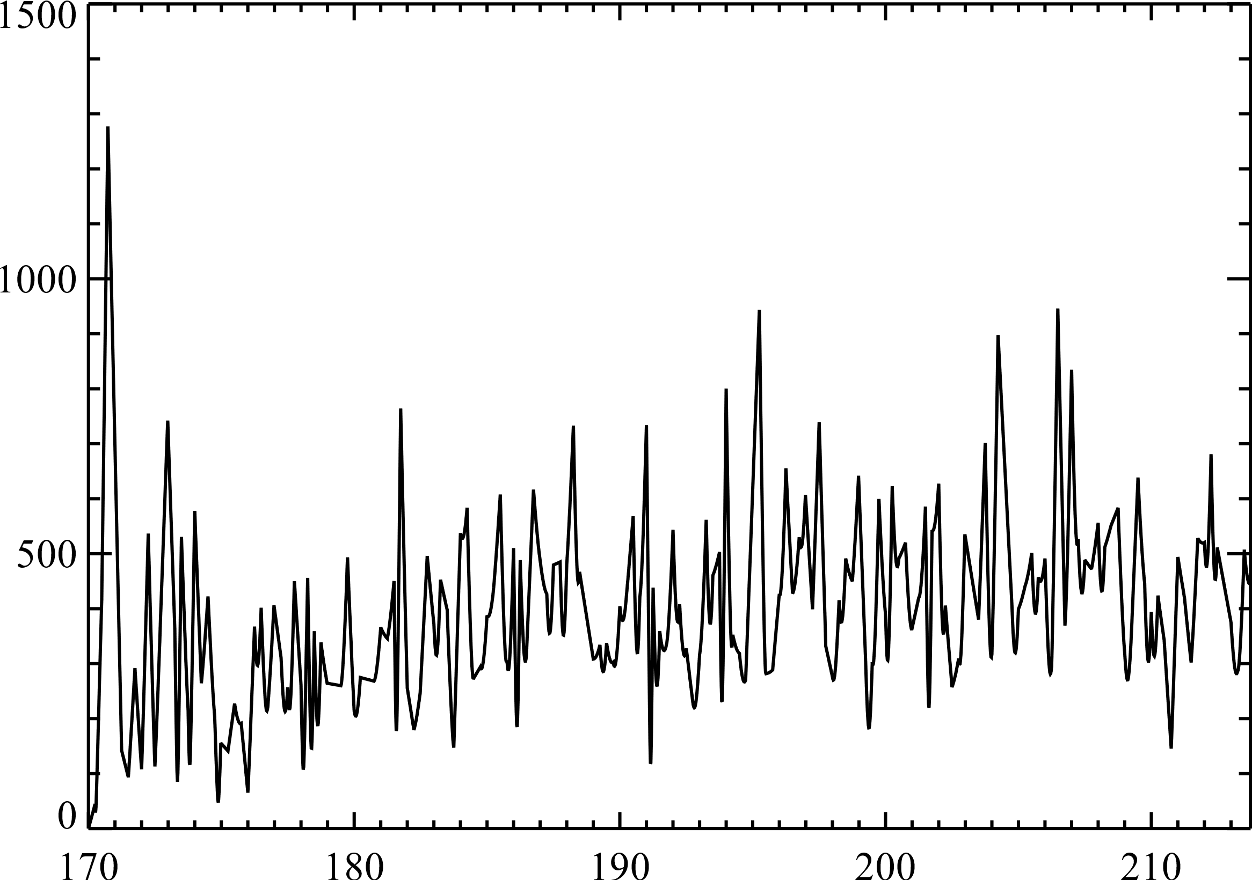
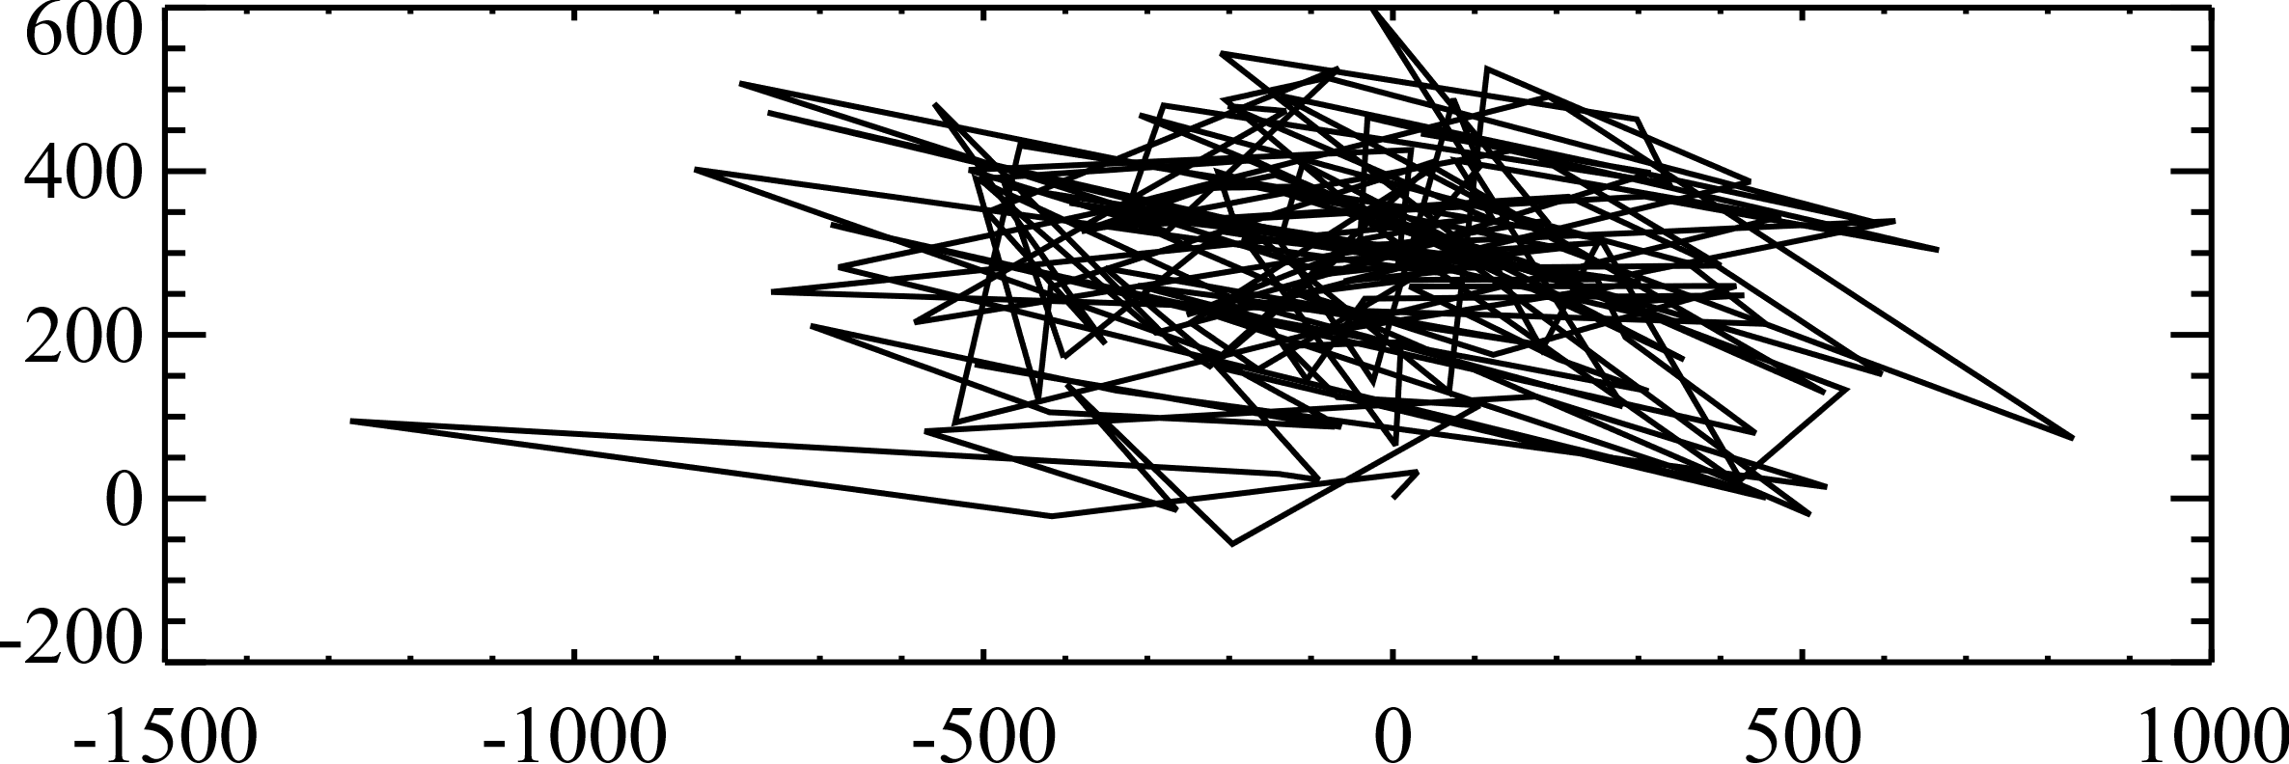
CGI bulk shear
(X,Y displacement at FSM relative to instrument carrier)
Pupil diameter
@ FSM = 40 mm
ΔShear (nm)
Hours
Y Shear (nm)
X Shear (nm)

Slide 31
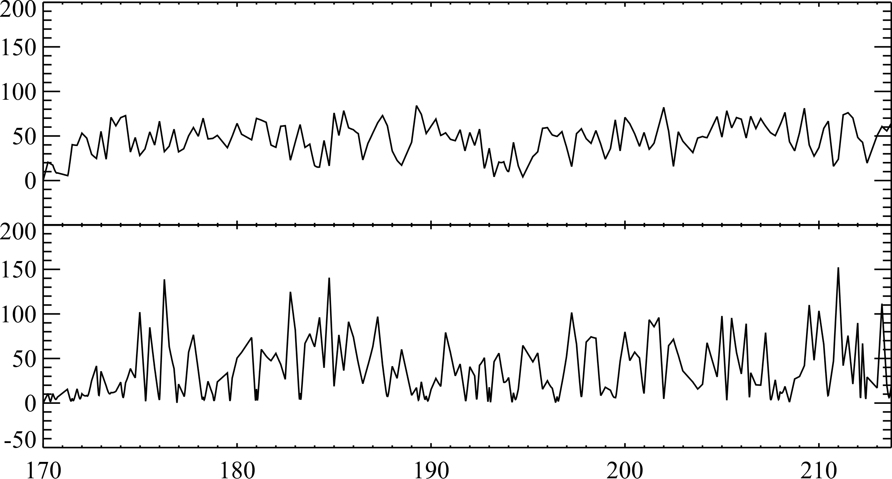
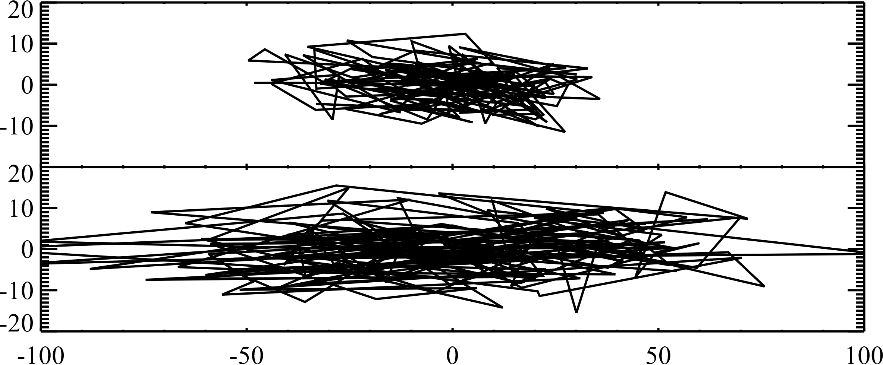


DM shear (CGI bulk shear subtracted)
DM 1
ΔShear (nm)
DM 2
Hours
DM 1
$$Y−\overline{Y} (nm)$$
DM 2
$$X−\overline{X} (nm)$$

Slide 32
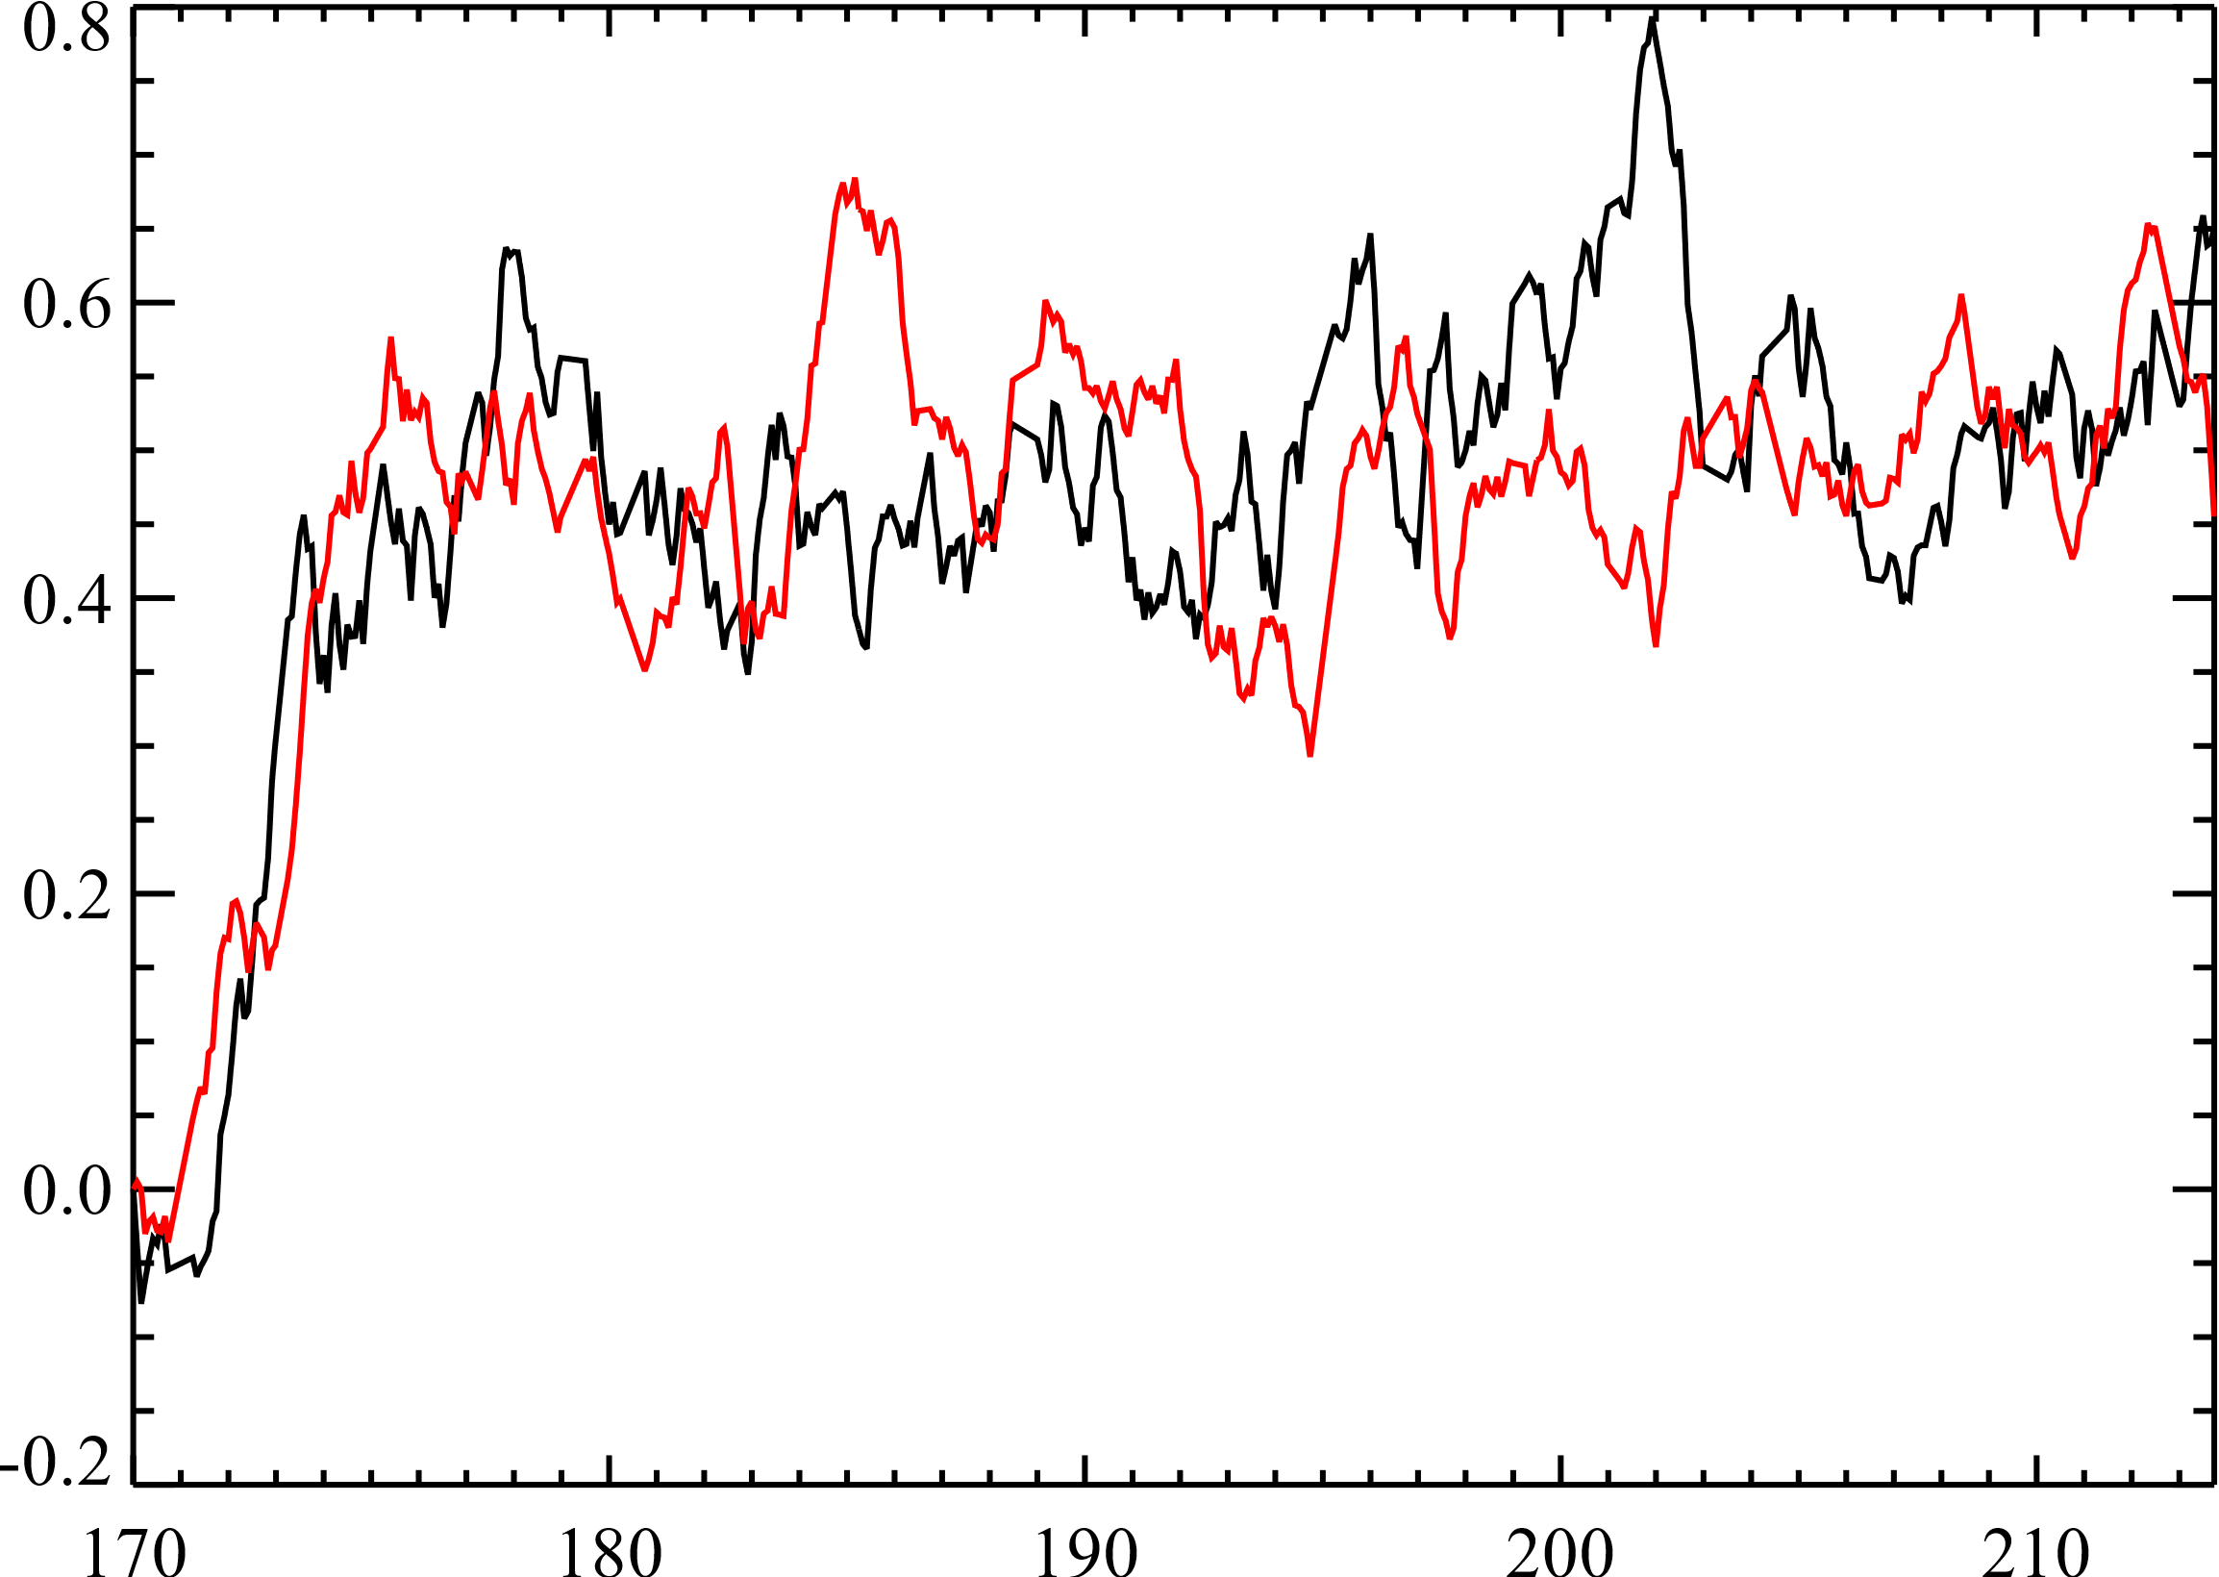
DM temperature change
DM ΔTemperature (mK)
DM 1
DM 2
Hours
DM surface change factor = (1 + 0.026 x ΔTemp_{K})
Max change here is ~0.0021% from t=170 h

Slide 33
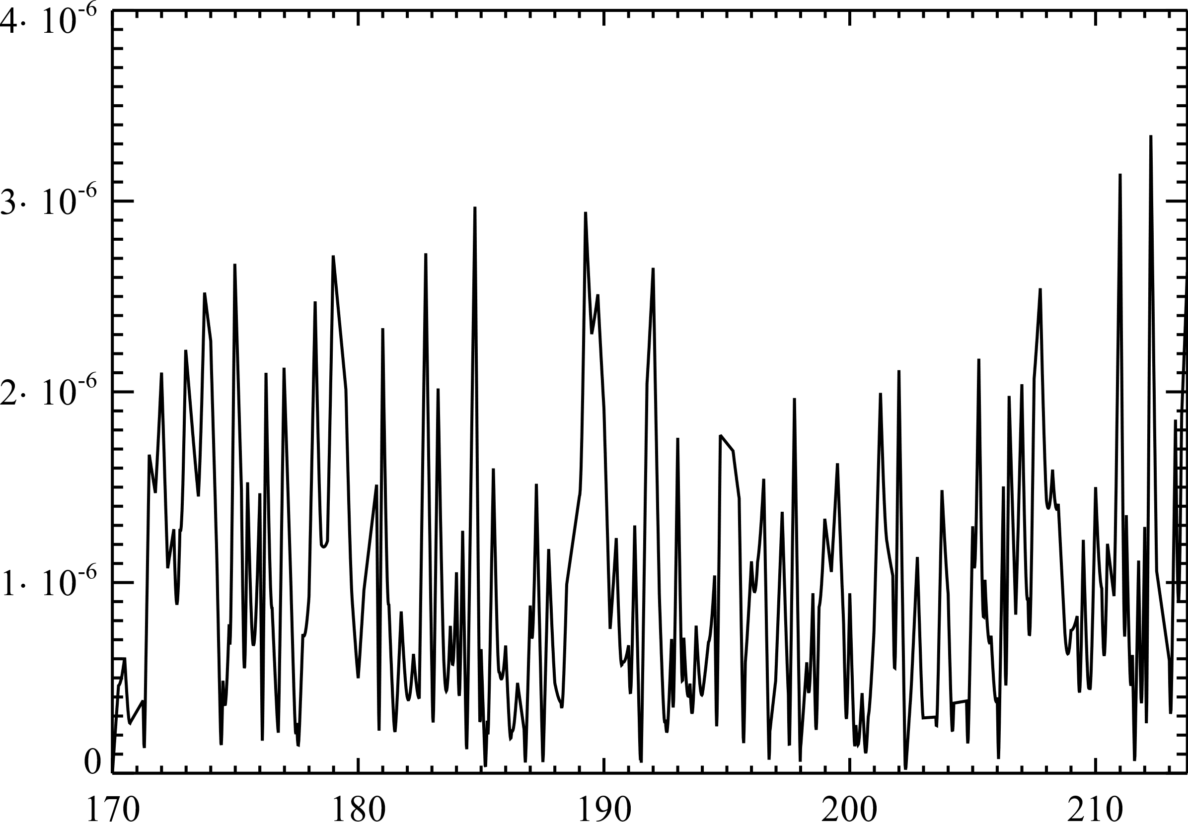
Lyot stop shear (CGI bulk shear subtracted)
Shear / Beam diameter
Hours

Slide 34
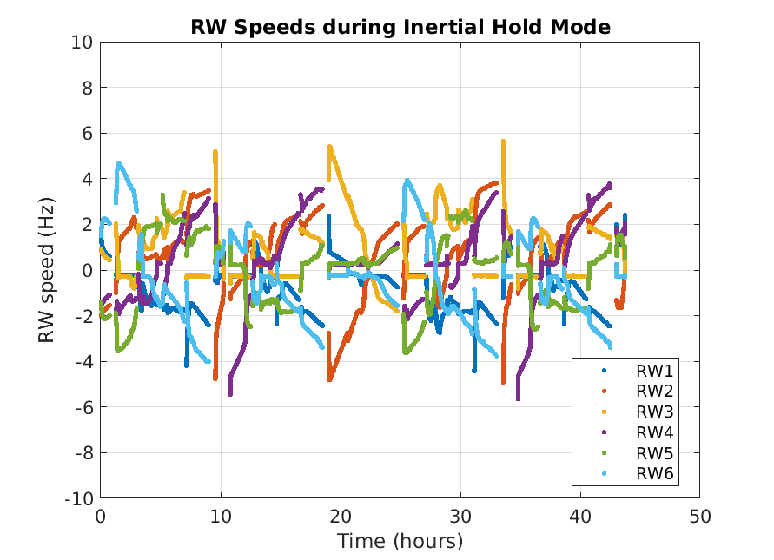
OS11 Reaction Wheel Speeds
Time (H) from 170 H

