Slide 1
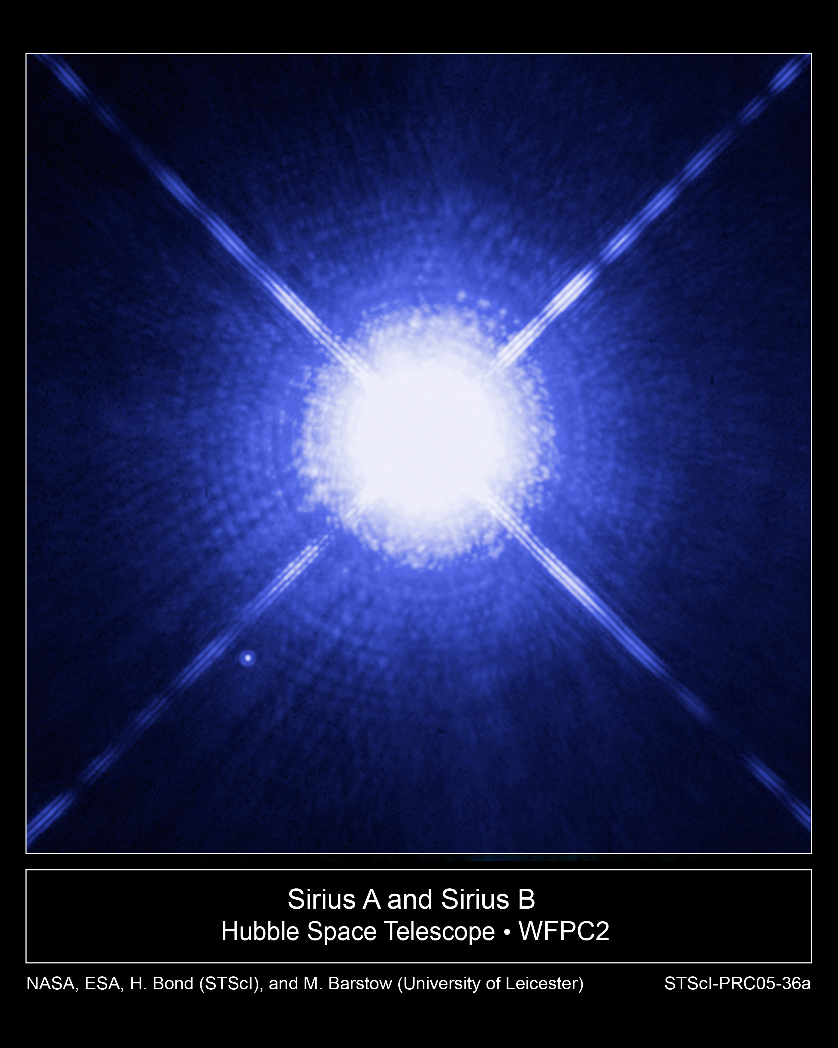
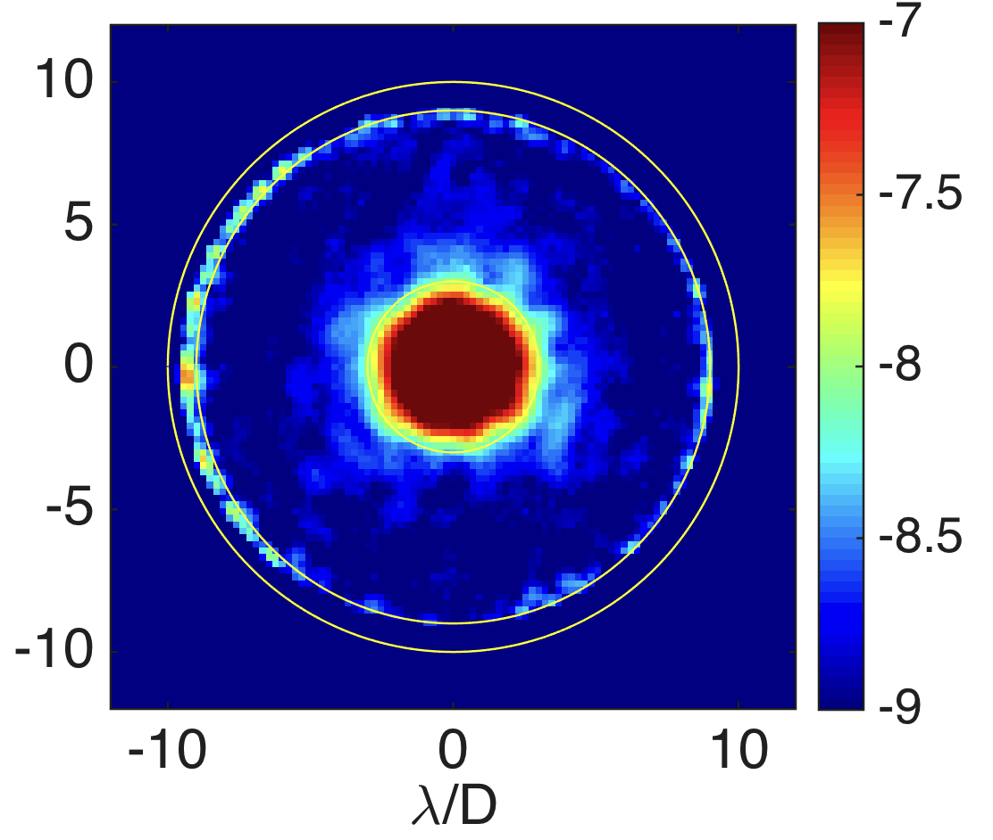
The WFIRST Coronagraph Instrument (CGI)
CGI is one of two instruments on WFIRST
  launch 2025
Exoplanets are challenging to directly image
  The planet is lost in the glare of the star
The best star to planet light flux ratio we can detect today is 10⁶
  Earth twin needs 10,000 times better
WFIRST CGI, a technology demonstration of space-based direct imaging, will be ~100-1,000 times better than any current telescope
  CGI will pave the way for future missions capable of taking spectra of Earth analogs
CGI will achieve pioneering science in direct imaging and spectroscopy of mature Jupiter analog exoplanets and circumstellar disks seen in visible reflected starlight
Notes:
Top Image: Image of a bright star (Sirius) with HST. A faint planet orbiting close to the star would be lost in the glare. The orange circle is the field of view of CGI.
Bottom Image: CGI lab demonstration of 1 billion to one contrast
Imaging a planet around a nearby star is really challenging. Imagine trying to see a firefly buzzing near a lighthouse. Now imagine that firefly is buzzing 20ft away from that lighthouse and you’re trying to see it from 1500 miles away (CA to MN). That’s what we can do today. To see an Earth-like planet around a Sun-like star, we need to do 10,000 times better than that. Replace that firefly with a single cell of bioluminescent algae.
The problem, of course, is that alga is lost under the glare of the lighthouse. The planet is lost in the glare of the star. (top image) We will have to specially design a telescope and instrument that block the starlight to see the extraordinarily faint planet. (bottom image)
A factor of 10,000x improvement is too much to do in one giant leap. CGI is a direct predecessor to these missions, and is a crucial step in the exploration of Sun-like planetary systems
CGI will be 1,000x better that any current telescope, and will be capable of seeing Jupiter-like planets around nearby stars. It will also be able to see
‘protoplanetary disks’ – the disk of dust and gas around a very young star out of which planets form
‘debris disks’ - the remnant material from planet formation, akin to massive versions of our asteroid or Kuiper belts
‘exozodiacal disks’ – the remnant material from planet formation and evaporating comets, akin to the dust that causes zodiacal light in our solar system
Details about top image: This Hubble Space Telescope image shows Sirius A, the brightest star in our nighttime sky, along with its faint, tiny stellar companion, Sirius B. Astronomers overexposed the image of Sirius A [at center] so that the dim Sirius B [tiny dot at lower left] could be seen. Sirius B is about 10,000 times fainter than Sirius A.
The cross-shaped diffraction spikes and concentric rings around Sirius A, and the small ring around Sirius B, are artifacts produced within the telescope's imaging system. Sirius B is about 10,000 times fainter than Sirius A, but it can be seen in this image because it is orbiting far away from Sirius A. (about 6 arcseconds) If we wanted to image planets orbiting close to Sirius A, or any other star, they would be much more difficult to detect, because of the glare of the star.
Details about bottom image:
This is a lab image taken with a WFIRST CGI prototype at JPL. The color scale is tells you how faint a planet you could detect at each position. In the darkest blue regions, you could see a planet that’s 1 billion times fainter than its star. [The point source is just powerpoint art, not a real source!]
Technical details: 360 deg dark hole, with a contrast ratio of 10-9 from 3 λ/D to 8 λ/D at wavelength λ, where D is the telescope diameter. Results shown are unpolarized light with a 10% bandwidth centered at 0.55 µm. (Jun-Byoung Seo et al., private communication, Dec. 2016).
Side note: what astrophysical measurements have been done on Sirius and why do we care? The two stars revolve around each other every 50 years. Sirius A, only 8.6 light-years from Earth, is the fifth closest star system known. Sirius B, a white dwarf, is very faint because of its tiny size, only 7,500 miles in diameter. White dwarfs are the leftover remnants of stars similar to the sun. They have exhausted their nuclear fuel sources and have collapsed down to a very small size.Using the keen eye of Hubble's Space Telescope Imaging Spectrograph (STIS), astronomers have now been able to isolate the light from Sirius B and disperse it into a spectrum. STIS measured light from Sirius B being stretched to longer, redder wavelengths due to the white dwarf's powerful gravitational pull. Based on those measurements, astronomers have calculated Sirius B's mass at 98 percent that of the sun. Analysis of the white dwarf's spectrum also has allowed astronomers to refine the estimate for its surface temperature to about 44,900 degrees Fahrenheit (25,200 degrees Kelvin).
Accurately determining the masses of white dwarfs is fundamentally important to understanding stellar evolution. The sun will eventually become a white dwarf. White dwarfs are also the source of Type Ia supernova explosions, which are used because of their brightness to measure the distance to distant galaxies and the expansion rate of the universe. Measurements based on Type Ia supernovae are fundamental to understanding "dark energy," a dominant repulsive force stretching the universe apart. Also, the method used to determine the white dwarf's mass relies on one of the key predictions of Einstein's theory of General Relativity: that light loses energy when it attempts to escape the gravity of a compact star. This effect is known as the gravitational redshift of the light.
This image was taken Oct. 15, 2003, with Hubble's Wide Field Planetary Camera 2. Based on detailed measurements of the position of Sirius B in this image, astronomers were then able to point the STIS instrument exactly on the white dwarf and make the measurements to determine its gravitational redshift and mass.
Tags
Hubble Telescope, Multiple Star Systems, Observations, Stars, White Dwarfs
Credits
NASA, H.E. Bond and E. Nelan (Space Telescope Science Institute, Baltimore, Md.); M. Barstow and M. Burleigh (University of Leicester, U.K.); and J.B. Holberg (University of Arizona)

