Slide 1
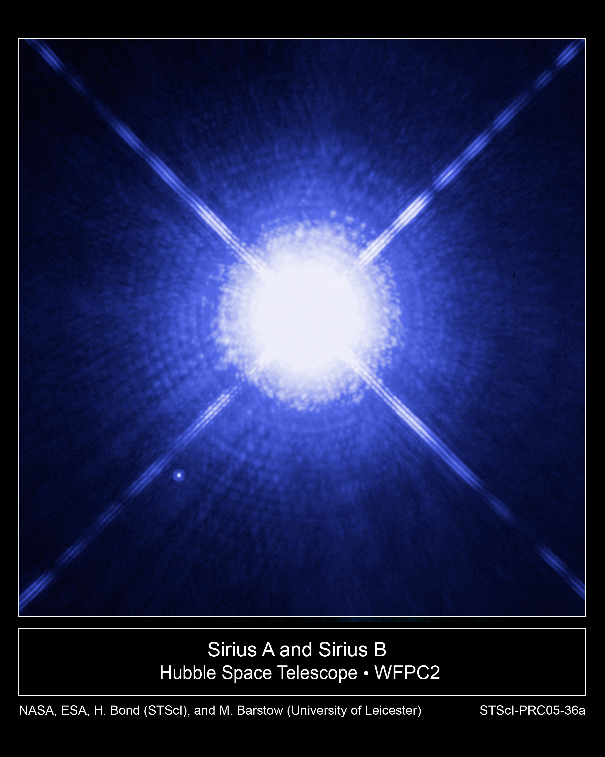
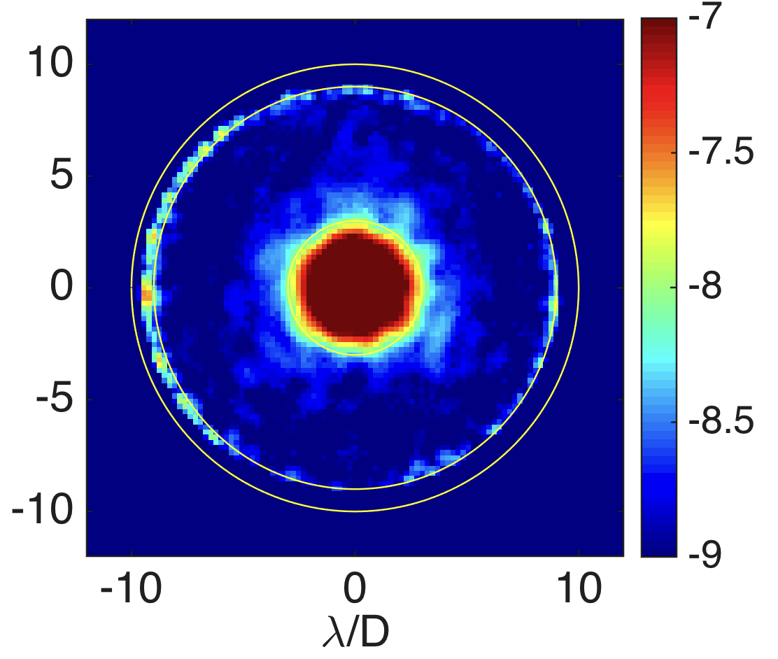
The WFIRST Coronagraph Instrument (CGI)
Exoplanets are challenging to directly image
  The planet is lost in the glare of the star
The best star-to-planet light flux ratio we can detect today is 1,000,000 to 1
  Earth twin needs 10,000 times better
CGI is one of two instruments on WFIRST
  launch 2025
  CGI will pave the way for future missions capable of taking spectra of Earth analogs
WFIRST CGI, a technology demonstration of space-based direct imaging, will be ~100-1,000 times better than any current telescope
CGI will achieve pioneering science in direct imaging and spectroscopy of mature Jupiter analog exoplanets and circumstellar disks seen in visible reflected starlight
Notes:
Top Image: Image of a bright star (Sirius) with HST. A faint planet orbiting close to the star would be lost in the glare. The orange circle is the field of view of CGI.
Bottom Image: CGI lab demonstration of 1 billion to one contrast
Imaging a planet around a nearby star is really challenging. Imagine trying to see a firefly buzzing near a lighthouse. Now imagine that firefly is buzzing 20ft away from that lighthouse and you’re trying to see it from 1500 miles away (CA to MN). That’s what we can do today. To see an Earth-like planet around a Sun-like star, we need to do 10,000 times better than that. Replace that firefly with a single cell of bioluminescent algae.
The problem, of course, is that alga is lost under the glare of the lighthouse. The planet is lost in the glare of the star. (top image) We will have to specially design a telescope and instrument that block the starlight to see the extraordinarily faint planet. (bottom image)
A factor of 10,000x improvement is too much to do in one giant leap. CGI is a direct predecessor to these missions, and is a crucial step in the exploration of Sun-like planetary systems
CGI will be 1,000x better that any current telescope, and will be capable of seeing Jupiter-like planets around nearby stars. It will also be able to see
‘protoplanetary disks’ – the disk of dust and gas around a very young star out of which planets form
‘debris disks’ - the remnant material from planet formation, akin to massive versions of our asteroid or Kuiper belts
‘exozodiacal disks’ – the remnant material from planet formation and evaporating comets, akin to the dust that causes zodiacal light in our solar system
Details about top image: This Hubble Space Telescope image shows Sirius A, the brightest star in our nighttime sky, along with its faint, tiny stellar companion, Sirius B. Astronomers overexposed the image of Sirius A [at center] so that the dim Sirius B [tiny dot at lower left] could be seen. Sirius B is about 10,000 times fainter than Sirius A.
The cross-shaped diffraction spikes and concentric rings around Sirius A, and the small ring around Sirius B, are artifacts produced within the telescope's imaging system. Sirius B is about 10,000 times fainter than Sirius A, but it can be seen in this image because it is orbiting far away from Sirius A. (about 6 arcseconds) If we wanted to image planets orbiting close to Sirius A, or any other star, they would be much more difficult to detect, because of the glare of the star.
Details about bottom image:
This is a lab image taken with a WFIRST CGI prototype at JPL. The color scale is tells you how faint a planet you could detect at each position. In the darkest blue regions, you could see a planet that’s 1 billion times fainter than its star. [The point source is just powerpoint art, not a real source!]
Technical details: 360 deg dark hole, with a contrast ratio of 10-9 from 3 λ/D to 8 λ/D at wavelength λ, where D is the telescope diameter. Results shown are unpolarized light with a 10% bandwidth centered at 0.55 µm. (Jun-Byoung Seo et al., private communication, Dec. 2016).
Side note: what astrophysical measurements have been done on Sirius and why do we care? The two stars revolve around each other every 50 years. Sirius A, only 8.6 light-years from Earth, is the fifth closest star system known. Sirius B, a white dwarf, is very faint because of its tiny size, only 7,500 miles in diameter. White dwarfs are the leftover remnants of stars similar to the sun. They have exhausted their nuclear fuel sources and have collapsed down to a very small size.Using the keen eye of Hubble's Space Telescope Imaging Spectrograph (STIS), astronomers have now been able to isolate the light from Sirius B and disperse it into a spectrum. STIS measured light from Sirius B being stretched to longer, redder wavelengths due to the white dwarf's powerful gravitational pull. Based on those measurements, astronomers have calculated Sirius B's mass at 98 percent that of the sun. Analysis of the white dwarf's spectrum also has allowed astronomers to refine the estimate for its surface temperature to about 44,900 degrees Fahrenheit (25,200 degrees Kelvin).
Accurately determining the masses of white dwarfs is fundamentally important to understanding stellar evolution. The sun will eventually become a white dwarf. White dwarfs are also the source of Type Ia supernova explosions, which are used because of their brightness to measure the distance to distant galaxies and the expansion rate of the universe. Measurements based on Type Ia supernovae are fundamental to understanding "dark energy," a dominant repulsive force stretching the universe apart. Also, the method used to determine the white dwarf's mass relies on one of the key predictions of Einstein's theory of General Relativity: that light loses energy when it attempts to escape the gravity of a compact star. This effect is known as the gravitational redshift of the light.
This image was taken Oct. 15, 2003, with Hubble's Wide Field Planetary Camera 2. Based on detailed measurements of the position of Sirius B in this image, astronomers were then able to point the STIS instrument exactly on the white dwarf and make the measurements to determine its gravitational redshift and mass.
Tags
Hubble Telescope, Multiple Star Systems, Observations, Stars, White Dwarfs
Credits
NASA, H.E. Bond and E. Nelan (Space Telescope Science Institute, Baltimore, Md.); M. Barstow and M. Burleigh (University of Leicester, U.K.); and J.B. Holberg (University of Arizona)

Slide 2


CGI Exoplanet Science Themes
Current Observations
Infrared wavelengths
Hot, super-Jupiters
Current ground-based observations are largely limited to infrared light. These observations only detect young, hot super-Jupiters
WFIRST/CGI will take the first visible-light image and spectrum of a cool, Jupiter-like exoplanet
    Cool planets can be seen by their reflected visible light.
    Visible wavelengths are sensitive to clouds and hazes
CGI provides the foundation for future missions that will search for life on exo-Earths
WFIRST/CGI
Visible and near-infrared wavelengths
Jupiter-like planets
Future Missions
Visible and near-infrared wavelengths
Earth-like, potentially habitable, planets
Notes:
WFIRST CGI has been developed to prove out the technology needed for future exo-Earth finding missions, and it will be able to do interesting science on Jupiter-like planets along the way.
Today, we can only image the youngest planets (<~100 million years old – the younger the better). This is because we can only detect planets that are ~1 million times fainter than their stars and only in infrared light. So we need planets that are hot and glowing brightly in the IR. Planets are born hot and cool as they age, so we can only study young planets today.
Today, ground-based telescopes outperform space-based telescopes in their ability to directly image planets. But even ground-based telescopes are limited. Turbulence in Earth’s atmosphere ‘twinkles’ the stars and causes more glare. It’s easier to ‘de-twinkle’ the stars (using “adaptive optics”) in the IR than in the visible, which is why astronomers now directly image planets in IR light.
In order to see mature, cold, Jupiter-like planets that don’t glow brightly in the IR, we must look at the visible light that’s reflected from their cloud tops. This is not possible with ground-based telescopes, and so we need CGI. CGI’s successors aim to study the visible light reflected off the surfaces of small, earth-like planets.
Exoplanet science goals for tech demo and beyond. Definitely mention projects that are in bold.
In TD:
Take first visible light images of a mature (ie: cold) Jupiter-like exoplanet. Make first mass measurements of Jupiter-like planets previously detected with Radial Velocity technique (ie: no orbit inclination vs mass degeneracy)
Take first visible light spectrum of a mature (ie: cold) Jupiter-like exoplanet. Make sure we know how to do spectroscopy on a planet that’s nearly a billion times fainter that the star it orbits. Critical lesson for exo-earth missions that must do planets that are 10 billion times fainter.
Take visible light spectrum of a young (ie: hot) super-Jupiter that was previously detected in infrared light. Visible light can detect different molecules than infrared light can.
Possible in PSP:
Search for new planets in the habitable zones of nearby stars. For the closest stars, CGI could detect planets a bit larger than Neptune in the habitable zone. More specifically, between 1-3au around the 10 “best” stars, CGI has more than >50% completeness for planets that are ~5 Earth radii or larger. Caveat: that’s capability not yield! (from Dmitry Savransky; see ‘astronomer’ slide deck for details). Many of these stars would also be targets of future exo-Earth finding missions, and so CGI could do reconnaissance. A massive planet in the hab zone might spell disaster for an earth-sized planet – so perhaps no news is good news?
Comparative study of Jupiter-like planets. Image a dozen or so known RV planets and compare their albedos.
Comparative study of hot young super-Jupiters. Take spectra of a dozen or so known young, self-luminous planets and brown dwarfs that were previously imaged in the IR.
Possible questions:
Why are the hot young super-Jupiters farther from their stars than the old cold Jupiter-like planets? Our current ‘adaptive optics’ technology doesn’t do a good enough job removing the glare close to the star. There are certainly young Jupiters closer to their stars, but we need WFIRST CGI to see them.

Slide 3
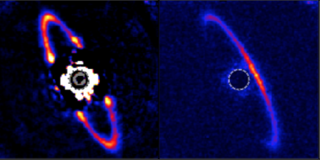
CGI Disk Science Themes
CGI will probe the formation and evolution of exosolar systems by observing three types of disks:
  Protoplanetary & Transition disks
    Newly-forming planetary systems
  Debris disks
    Remains of planet formation + colliding or evaporating asteroids and comets
  Exozodi disks
    Colliding or evaporating asteroids and comets
    Can potentially obscure small Earth-like planets from observation
ESO/A. Müller et al.
Perrin et al. (2015)
NASA/JPL-Caltech
Notes:
Top image: Infrared image of PDS70, a protoplanetary disk; the blob to the right of the blocked-out star is a newly-formed planet that is carving out (dark) regions in the disk.
Middle images: Images of the debris disk around HR 4796 (star is blocked out). Left = normal infrared image. Right = infrared image in polarized light only. The addition of polarimetry allows CGI to study the scattering properties of the circumstellar material, which in turn constrains dust grain size and composition.
Bottom image: artist’s conceptional image of a solar system with a massive exozodiacal dust disk (left) and minimal exozodi disk (right). Exozodi can obscure Earth-like planets; CGI will survey the highest priority targets to search for exozodi to help support observations by future missions that will search for potentially habitable exo-Earths
To understand the formation and evolution of exosolar systems, it’s important to study not only the exoplanets, but their surroundings. Stars form when dust and gas collapse under the pull of gravity.
During this formation process, the infalling dust and gas form a disk of material around the star. It’s in this so-called protoplanetary disk that planets form.
As the planet and star formation process proceeds, most of the material in the protoplanetary disk is used up, leaving only a few remnants behind (think of our asteroid and Kuiper belts). These remnants are called debris disks.
When asteroids or comets are jostled by planets and kicked into the inner planetary systems, they can crumble and evaporate and leave behind more dust. In our own solar system, the dust in the neighborhood of the rocky planets is called zodiacal dust, and so we call the equivalents in other systems exozodiacal disks, or “exozodi.” Exozodi are a potential problem for future missions that want to image earth-like planets, because the dust could obscure the planets from view.
Today, both ground-based telescopes and the Hubble Space Telescope take images of disks of all kinds. CGI will be able to see the inner regions that are lost under the glare of the star in HST images. Today’s ground based telescopes can see closer to the stars than HST can, but they’re best at taking infrared images and they can’t see faint, tenuous disks. CGI will be the best of both worlds: it will be able to see faint disks very closer to their stars at visible wavelengths.
In the CGI Tech Demo phase:
Total intensity images of a very faint debris disk close to a star in visible light. Taking images in two colors of light will start to constrain the types of grains that might be present. CGI can look for warps or gaps in the debris that might indicate the presence of unseen planets.
polarized light images of a massive debris disk in visible light. The addition of polarimetry allows CGI to study how the dust grains scatter light, which in turn constrains dust grain size and composition.
Search for exozodi in an interesting exosolar system. Take a deep image of a system that might have an earth-like planet, to make sure it doesn’t have a bright exozodi disk that would obscure the earth-like planet when observed with a future earth-finding telescope.
In the Participating Scientist Program:
Take images of protoplanetary disks to better understand the planet formation process by looking for gaps or warps in the disks that might be caused by unseen forming planets.
Search for forming protoplanets directly by taking images in a wavelength of light (H-alpha) that these planets emit when they’re growing by accreting material from the surrounding disk.
Conduct a search for exozodi around the 10-20 highest priority stars for future exo-Earth finding missions. After this survey, we can be confident that there are no bright exozodi obscuring the view for future missions.

Slide 4
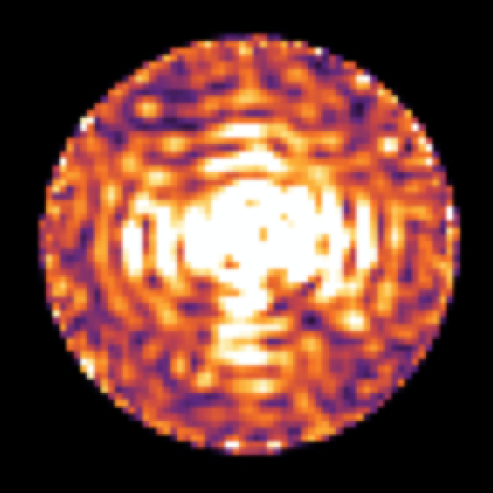
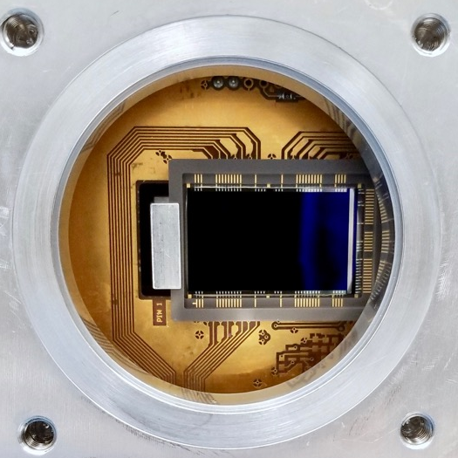
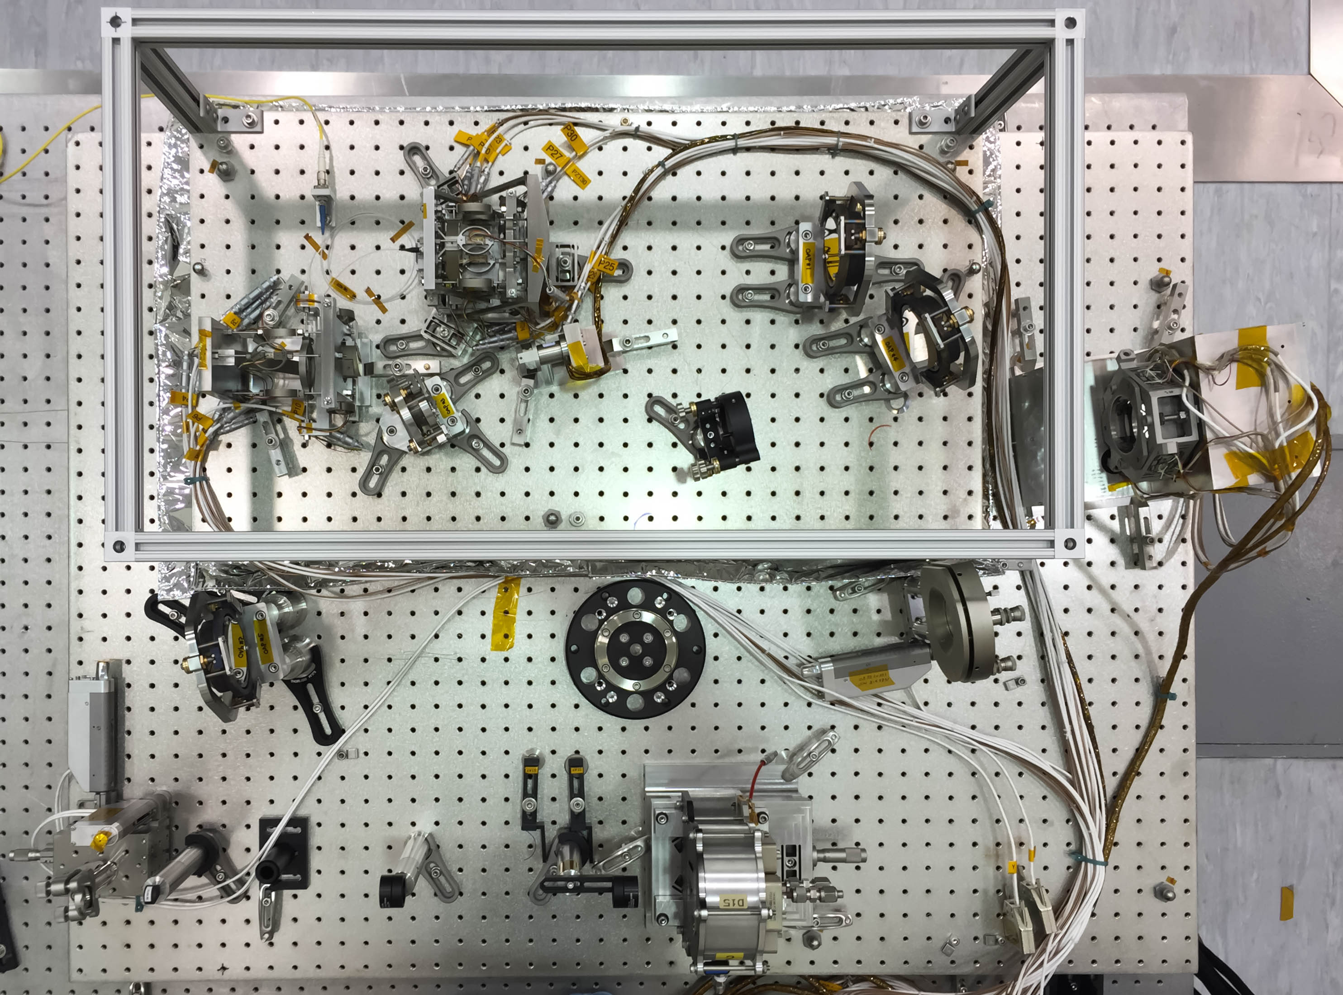
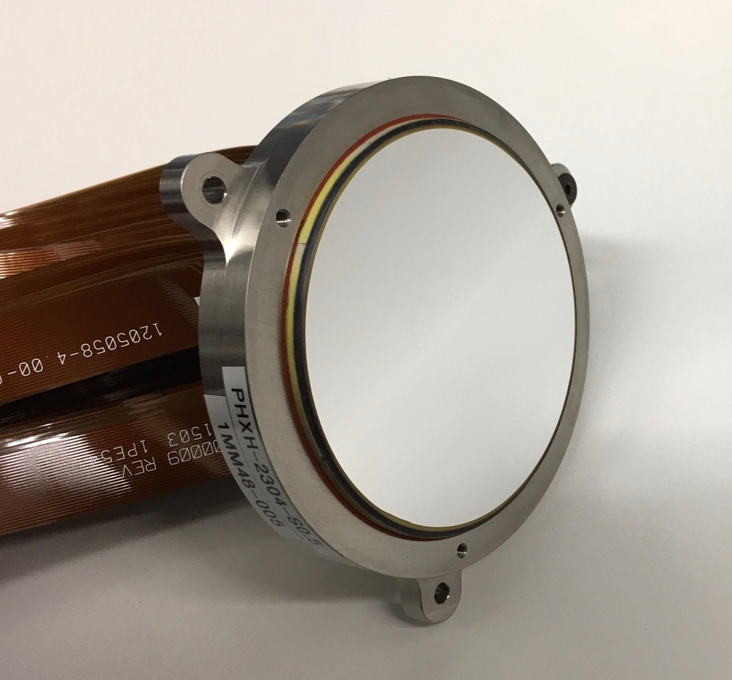
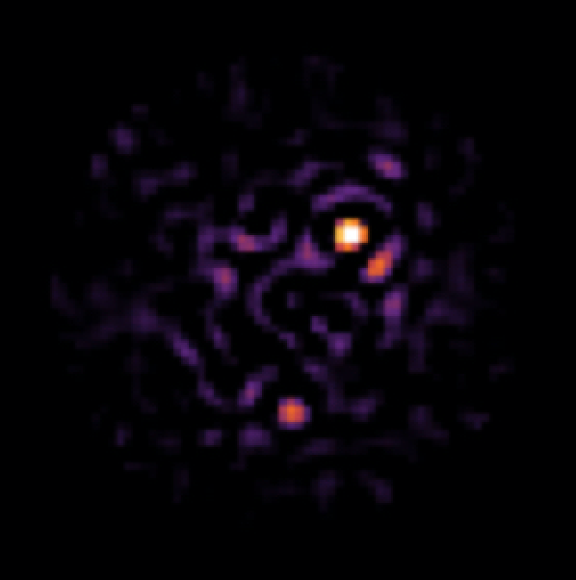
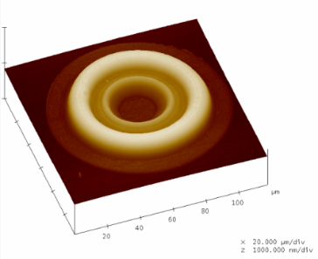
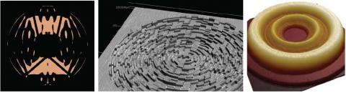
Critical Technology Demonstrations
CGI is an advanced technology demonstrator for future missions that will directly image Earth-like exoplanets.
High-contrast Coronagraph Masks
Ultra-low noise photon counting EMCCD Detectors
Data Post-
Processing
Autonomous
Ultra-Precise Wavefront Sensing & Control
Large-format Deformable Mirrors
Bertrand Mennesson (JPL)
  CGI will be the first space-based demonstration of technologies that will be needed to image and characterize rocky planets in the habitable zones of nearby stars.
  CGI is a direct predecessor to future missions such as HabEx and LUVOIR missions, and is a crucial step in the exploration of Sun-like planetary systems
Notes:
CGI is an advanced technology demonstrator for future missions that will directly image Earth-like exoplanets. (e.g. HabEx and LUVOIR)
As discussed before, these future missions to image earth-like planets will have to perform 10,000x better than today’s facilities. By demonstrating these tools in an integrated end-to-end system and enabling scientific observing operations, NASA will validate performance models and provide the pathway for potential future flagship missions.
In short, CGI achieves that capability through improvements in several areas:
Hardware: space-qualified (TRL9) deformable mirrors, detectors, and coronagraphs
Algorithms: wavefront sensing and control; post-processing of integral field spectrograph, polarimetric, and extended object data
Validation of telescope and instrument models at high accuracy and precision
Suppressing the starlight requires a combination of two things:
blocking as much starlight as possible with “coronagraph masks,” (think of how you use your hand to block the sun if you want to see a plane flying by)
Automatically measuring the remaining glare and correcting for it with a “deformable mirror.” Since light is a wave, astronomers call this process “wavefront sensing and control.” Deformable mirrors must be shaped very precisely in real time.
CGI will be the first space telescope with high-performance wavefront sensing and control. One of CGI’s primary goals is to figure out how to translate this ground-based technology into a hardy, space-qualified system, while simultaneously improving its performance by orders of magnitude. State of the art ground-based systems today can sense and correct wavefront errors to <100 nanometers (RMS). CGI must stabilize the wavefront to <100 picometers (RMS), and future exo-Earth imaging missions aim for <10 pm RMS.
CGI’s specially-designed coronagraph masks block starlight much better than those on current telescopes. These designs also have to be robust to effects that aren’t important at today’s poorer level of performance (such as accounting for the differences between the image quality in each polarization of light).
CGI will have advanced scientific cameras. It will include an ‘integral field spectrograph’ – a type of camera that takes a low resolution spectrum at every point in the image simultaneously. The most novel technology, though, is the electron-multiplying CCD (EMCCD) detector. This detector has exceptionally good sensitivity at very low light levels, and CGI will use it in uncharted territory – photon counting mode. A Jupiter-like planet around a nearby star is so faint that CGI will only receive photons from it once every couple minutes. CGI will literally count the photons as they arrive. JPL is working to space qualify these EMCCDs and characterize their performance at an unprecedented level of precision.
CGI must also build sophisticated data processing software, because even the precision coronagraphs + wavefront sensing and control can’t remove all the starlight. Data processing software must be able to remove the last of the remaining starlight to uncover the faint planets beneath.

